Slide 3
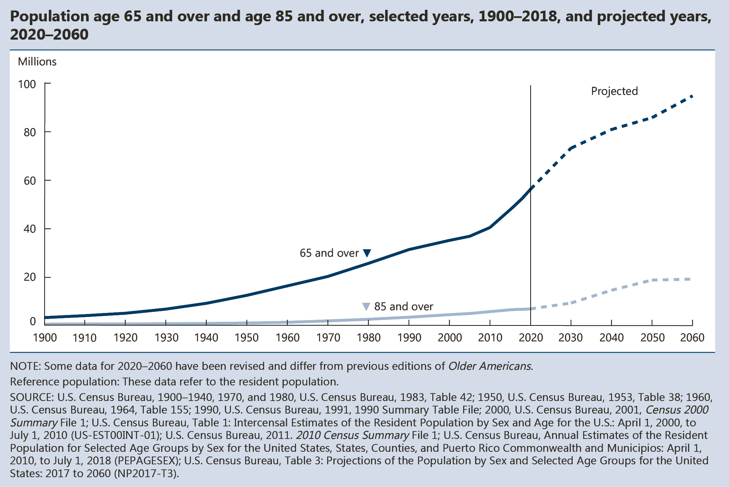
INDICATOR 1: Number of Older Americans

Slide 4
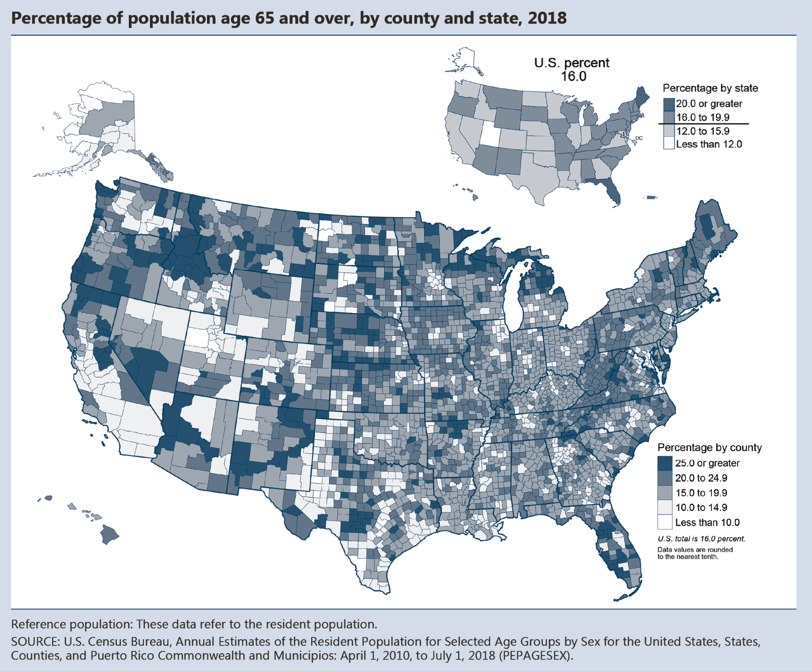
INDICATOR 1: Number of Older Americans (continued)

Slide 5
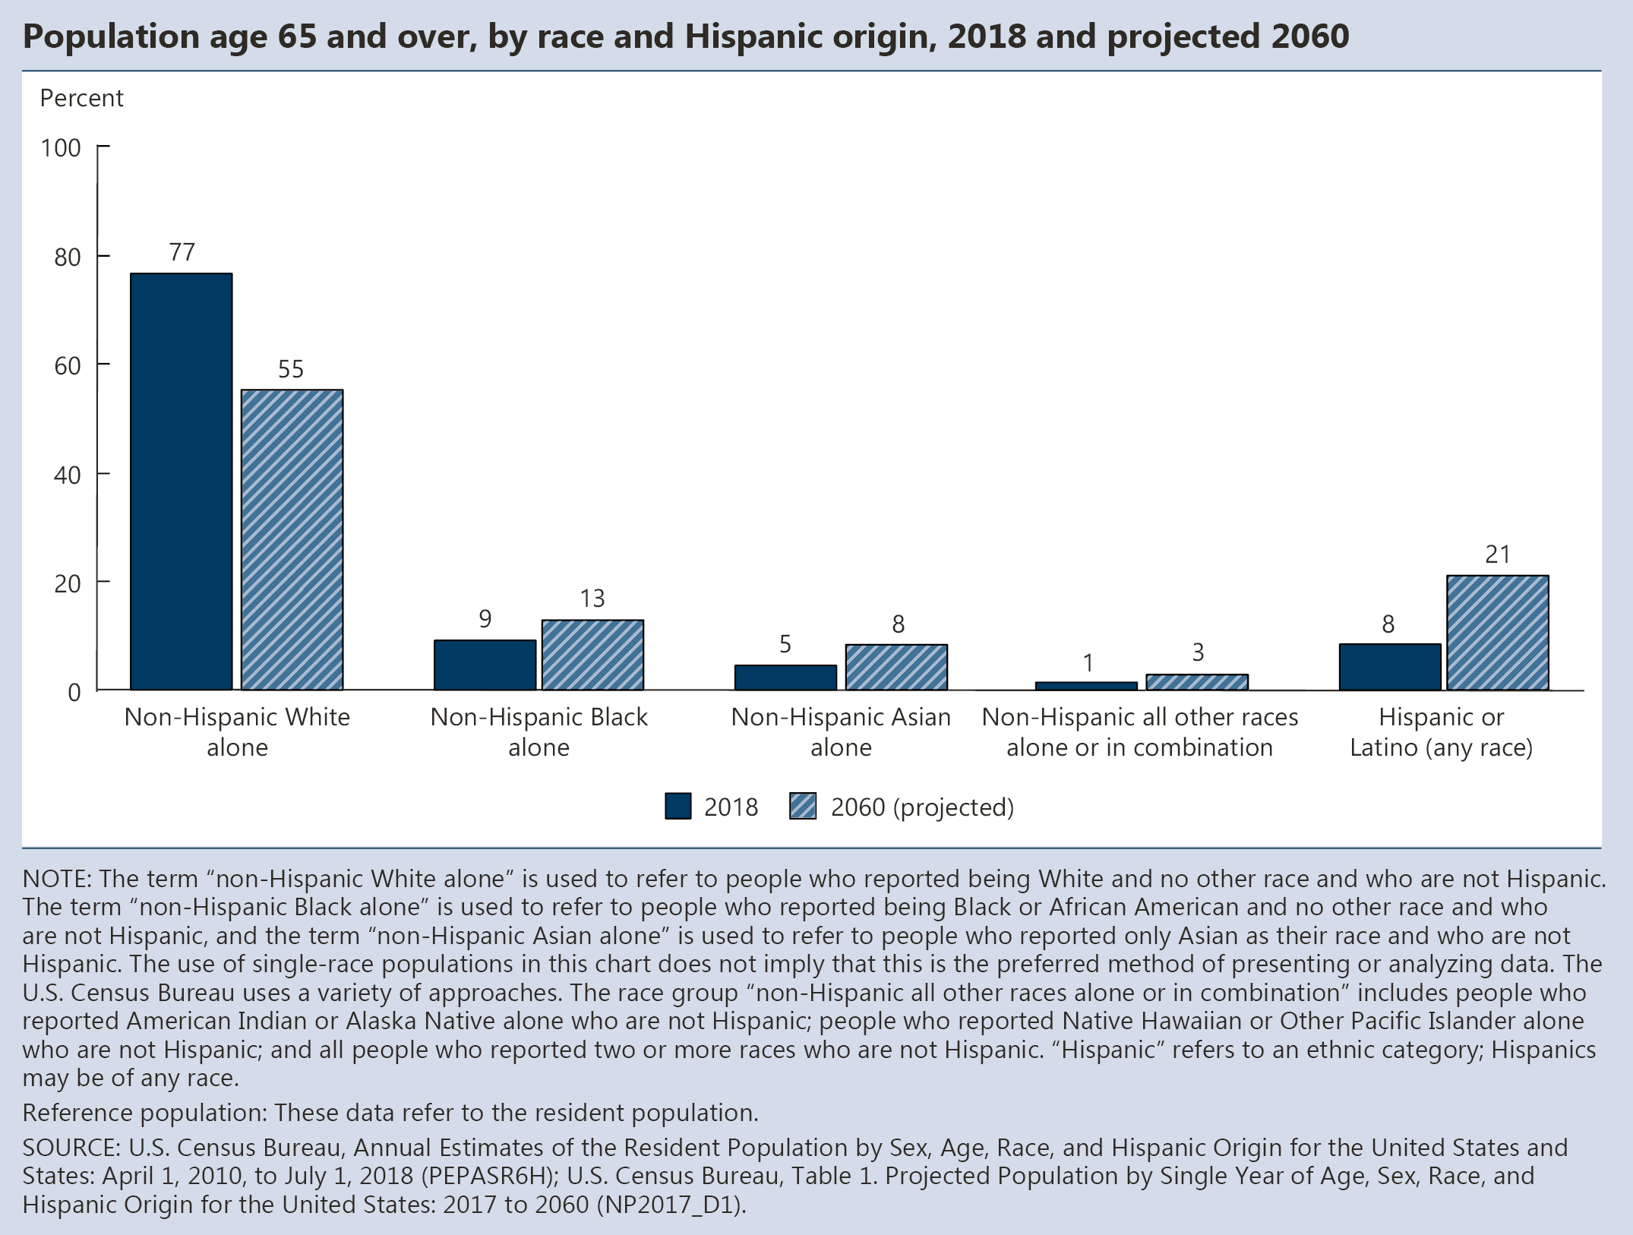
INDICATOR 2: Racial and Ethnic Composition

Slide 6
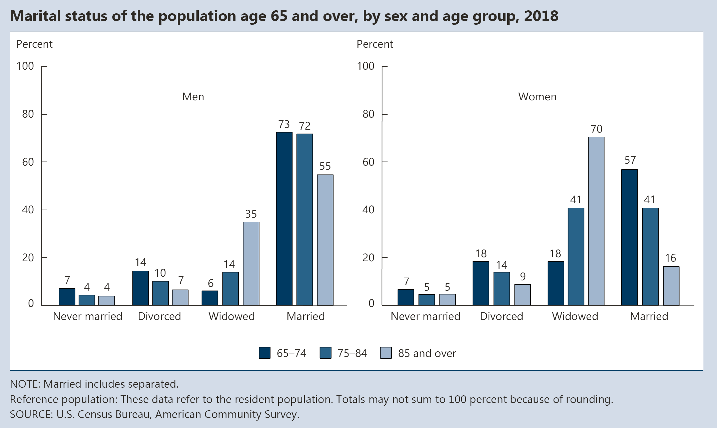
INDICATOR 3: Marital Status

Slide 7
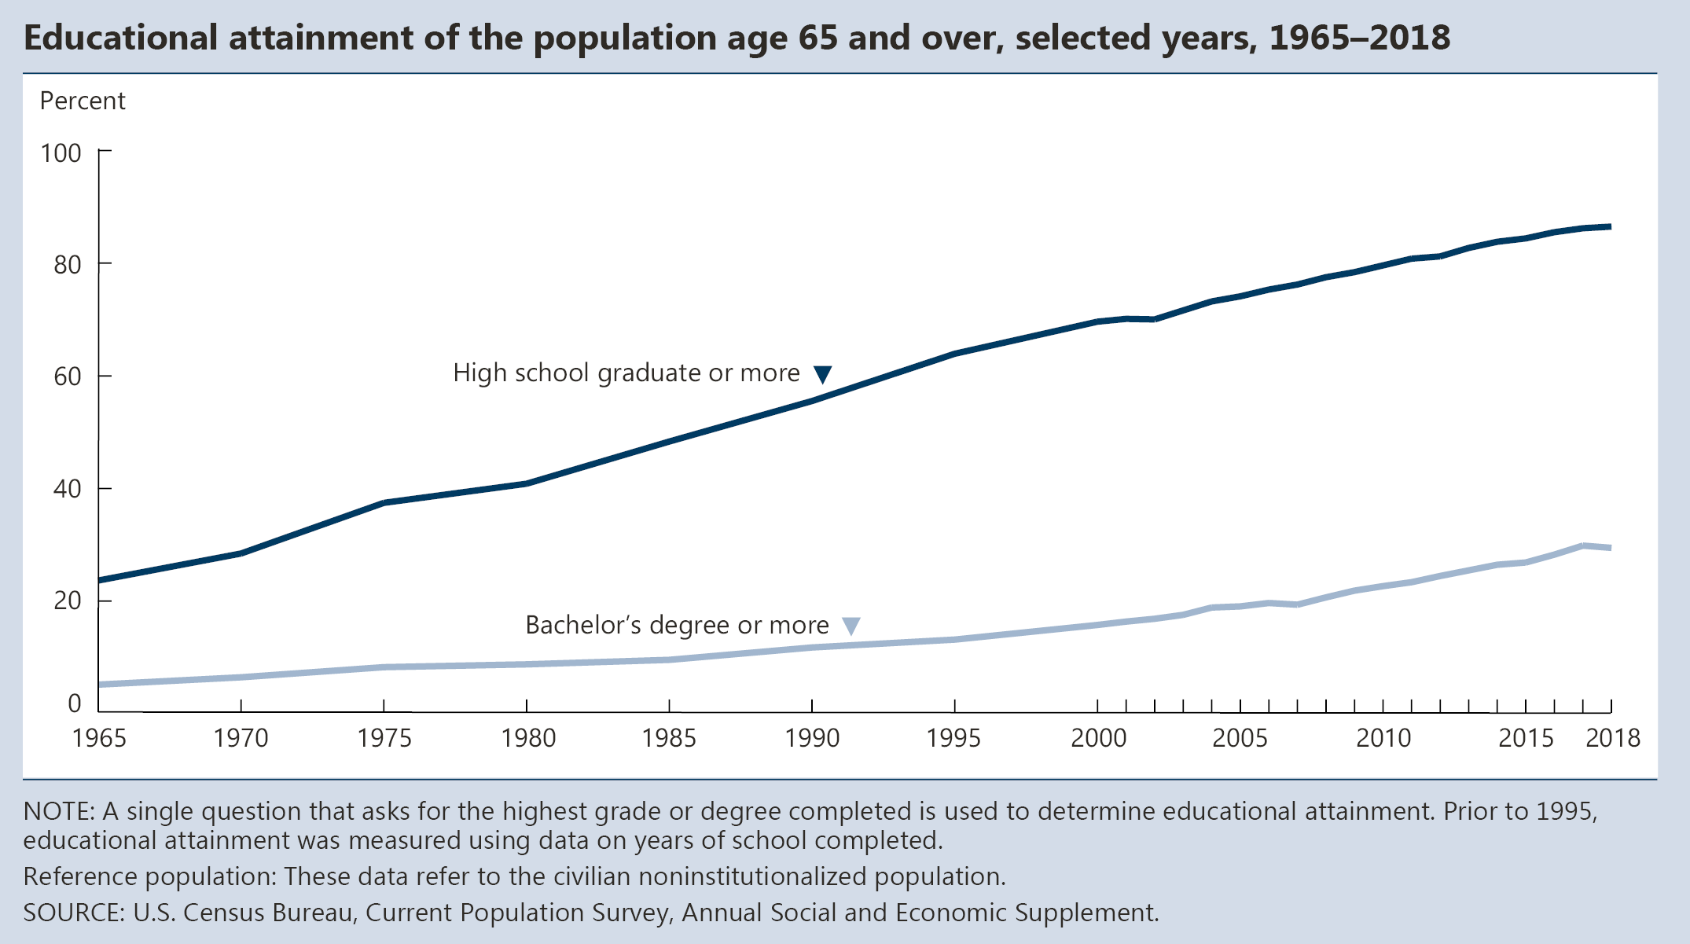
INDICATOR 4: Educational Attainment

Slide 8
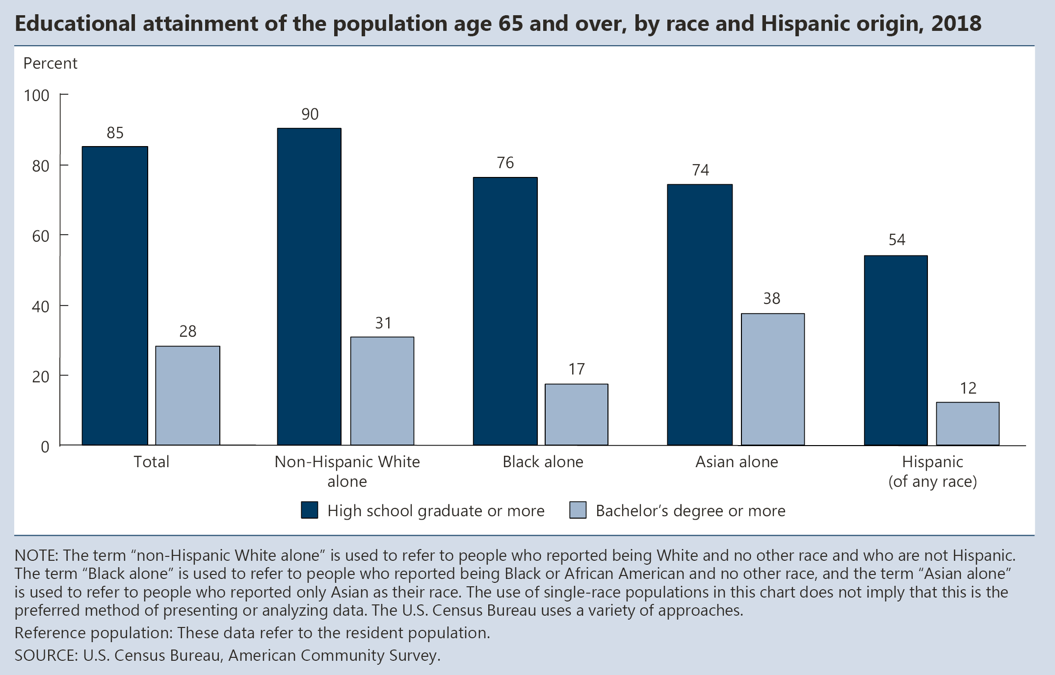
INDICATOR 4: Educational Attainment (continued)

Slide 9
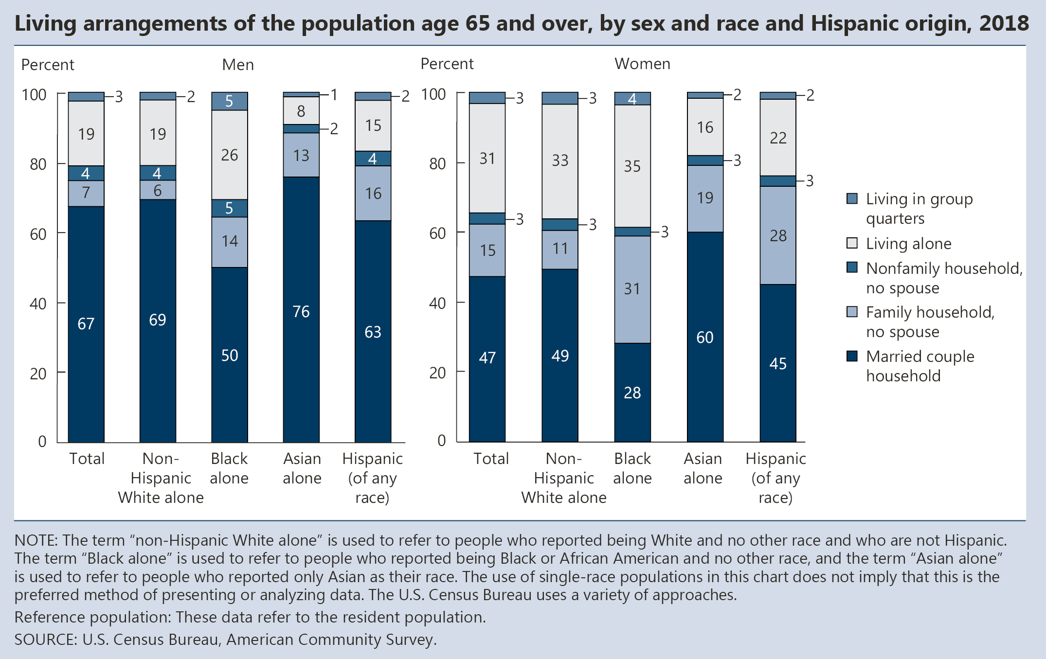
INDICATOR 5: Living Arrangements

Slide 10
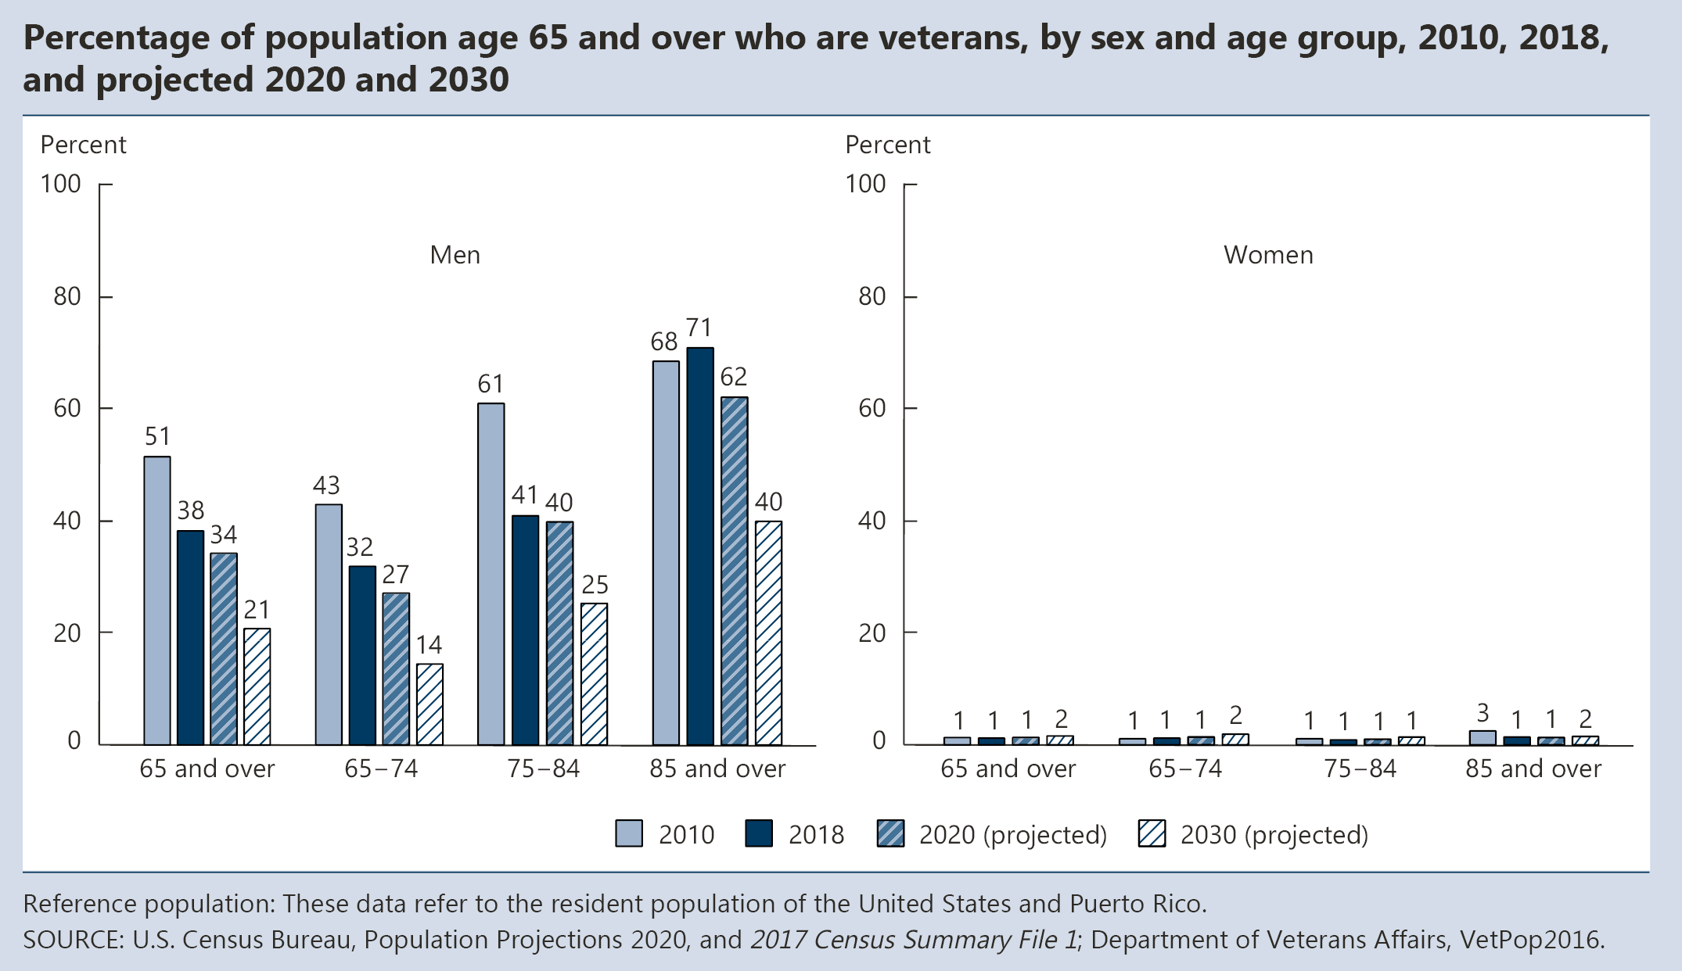
INDICATOR 6: Older Veterans

Slide 12
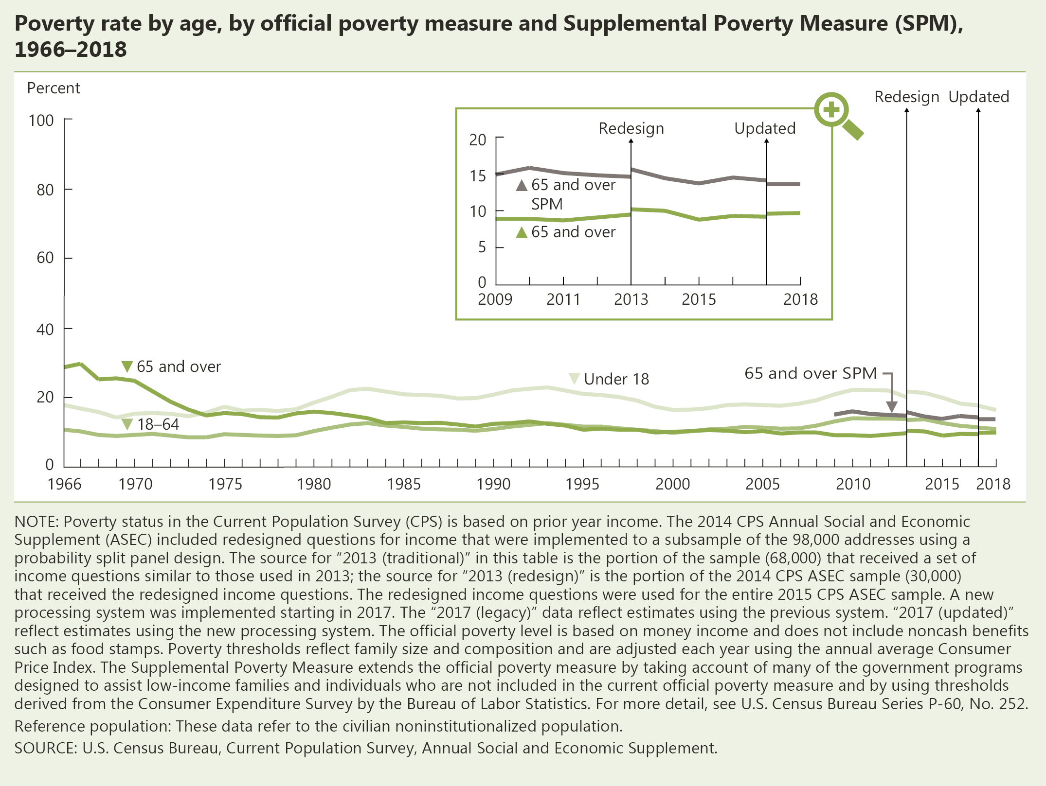
INDICATOR 7: Poverty

Slide 13
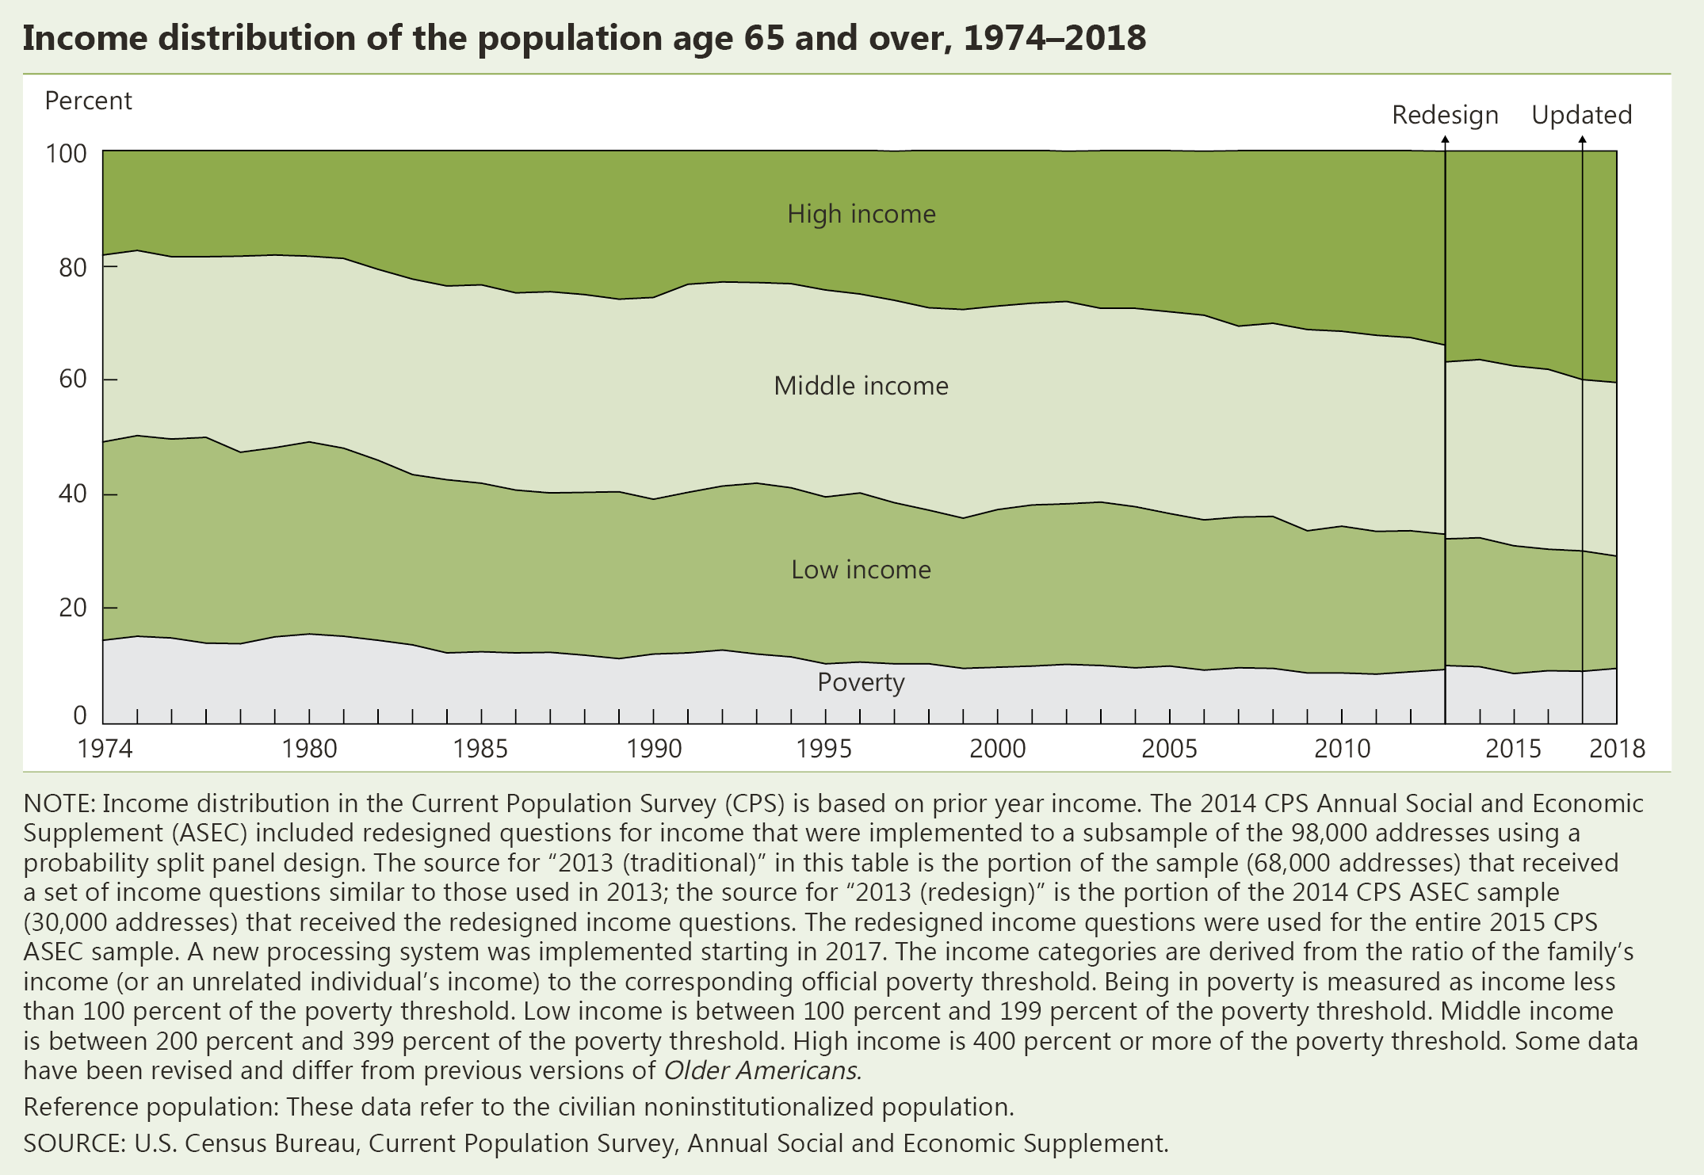
INDICATOR 8: Income

Slide 14
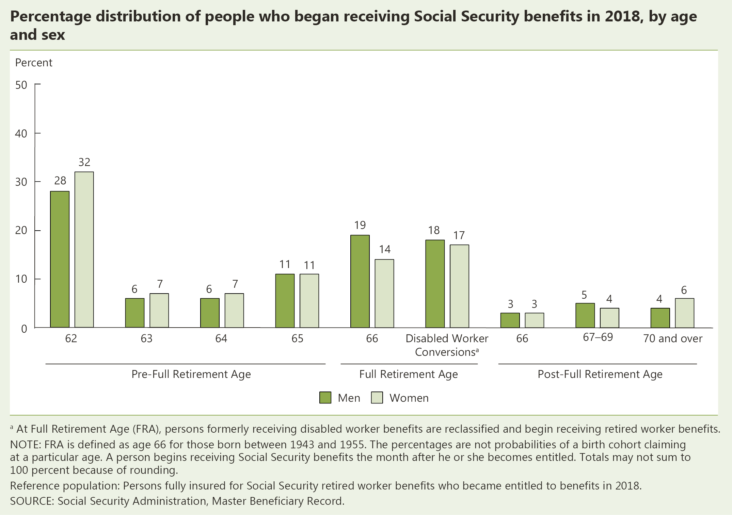
INDICATOR 9: Social Security Beneficiaries

Slide 15
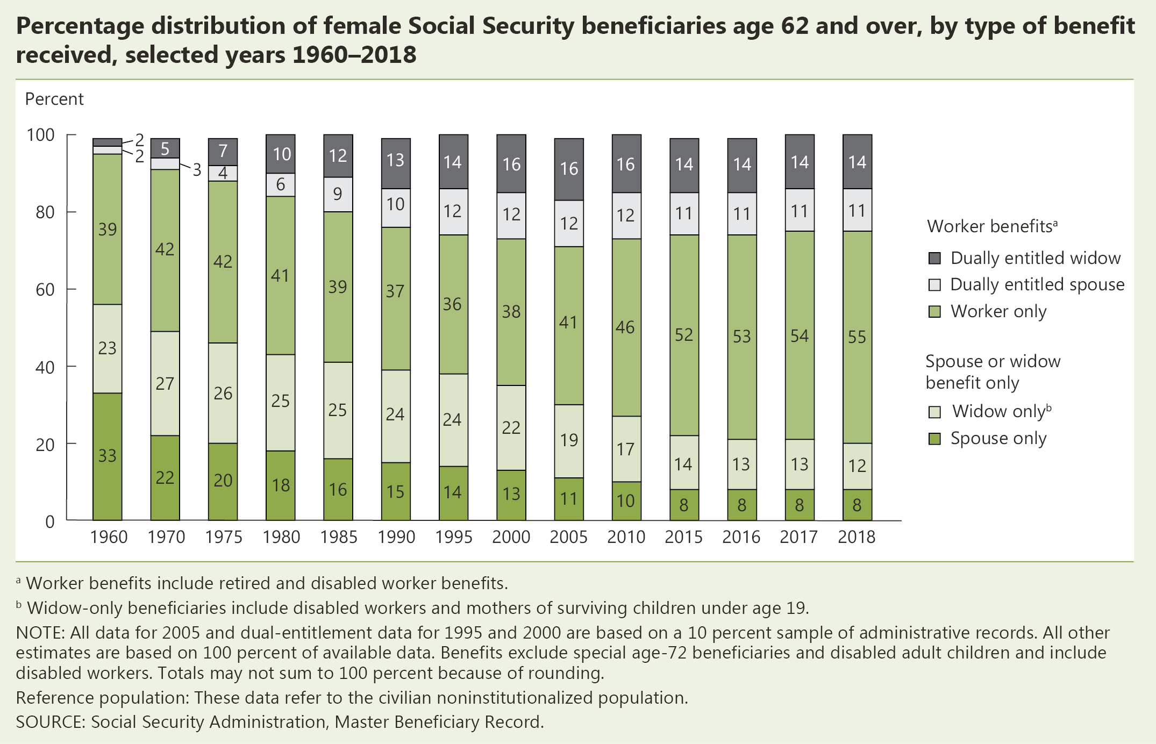
INDICATOR 9: Social Security Beneficiaries (continued)

Slide 16
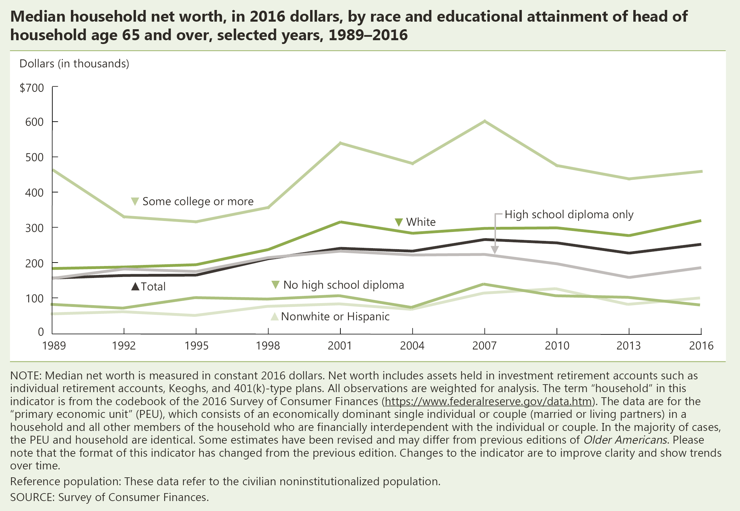
INDICATOR 10: Net Worth

Slide 17
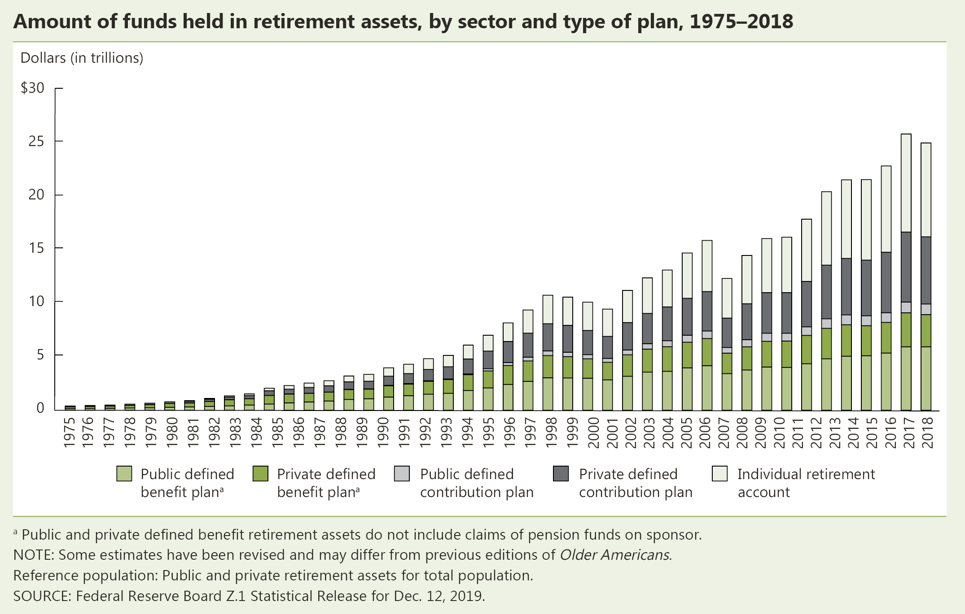
INDICATOR 10: Net Worth (continued)

Slide 18
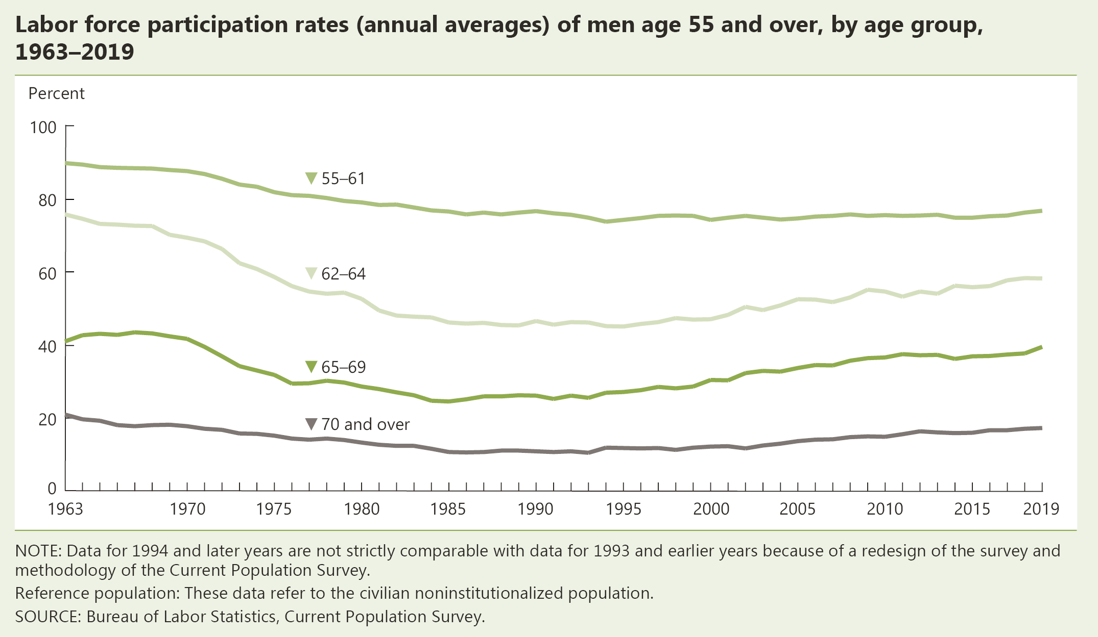
INDICATOR 11: Participation in Labor Force

Slide 19
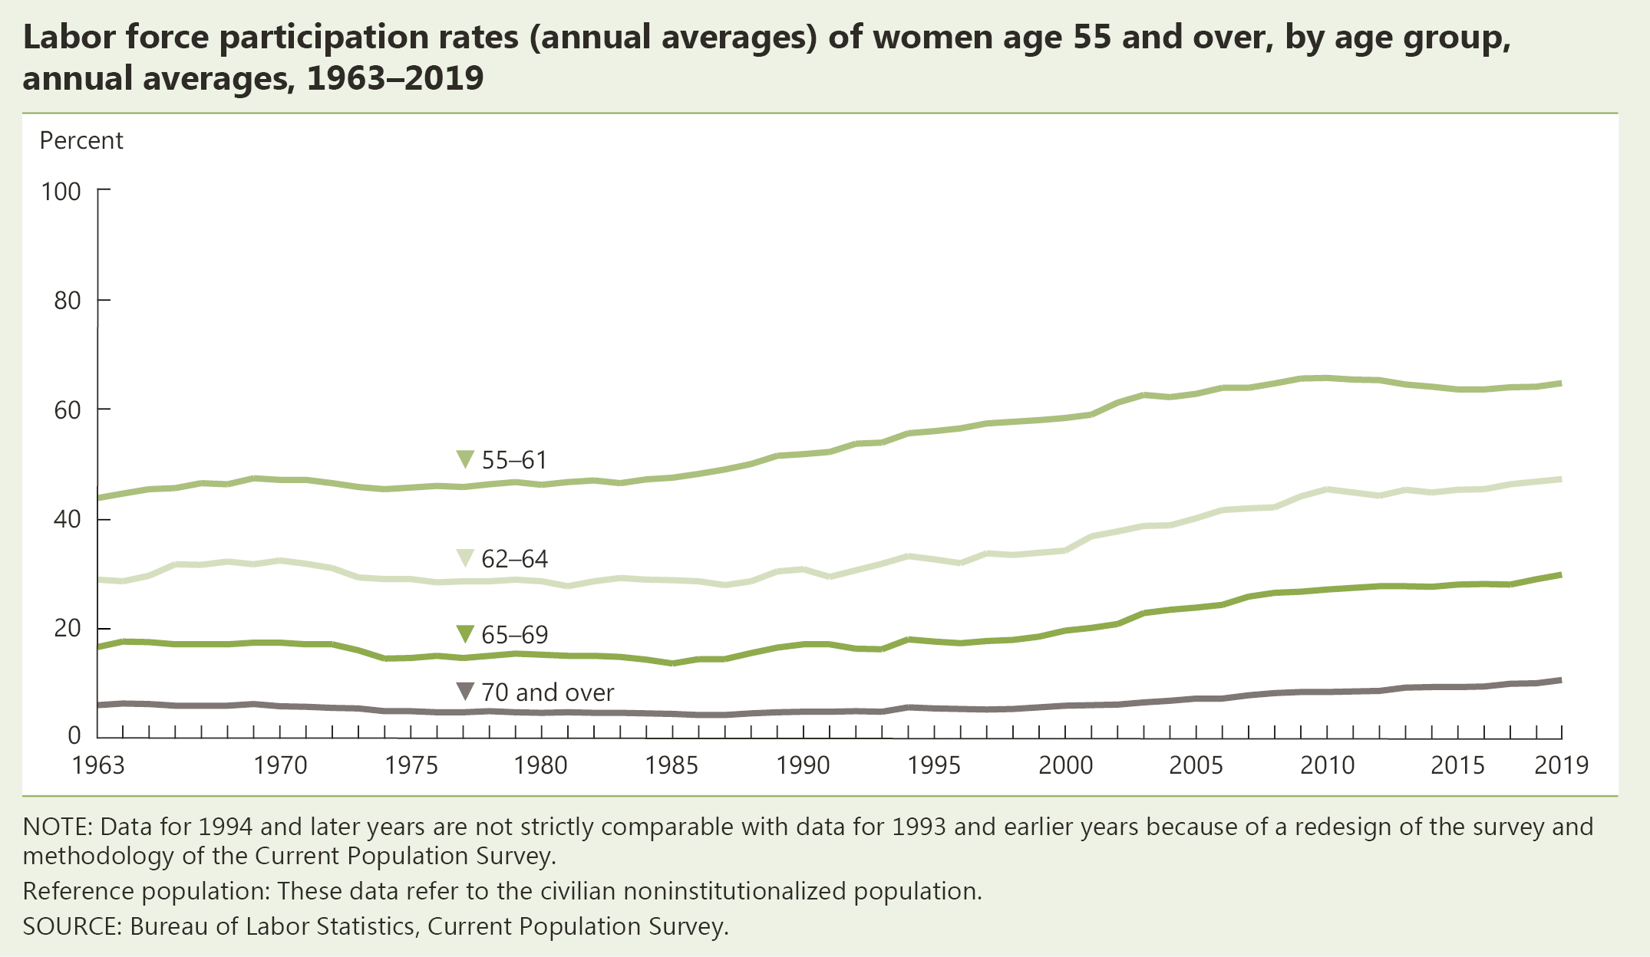
INDICATOR 11: Participation in Labor Force (continued)

Slide 20
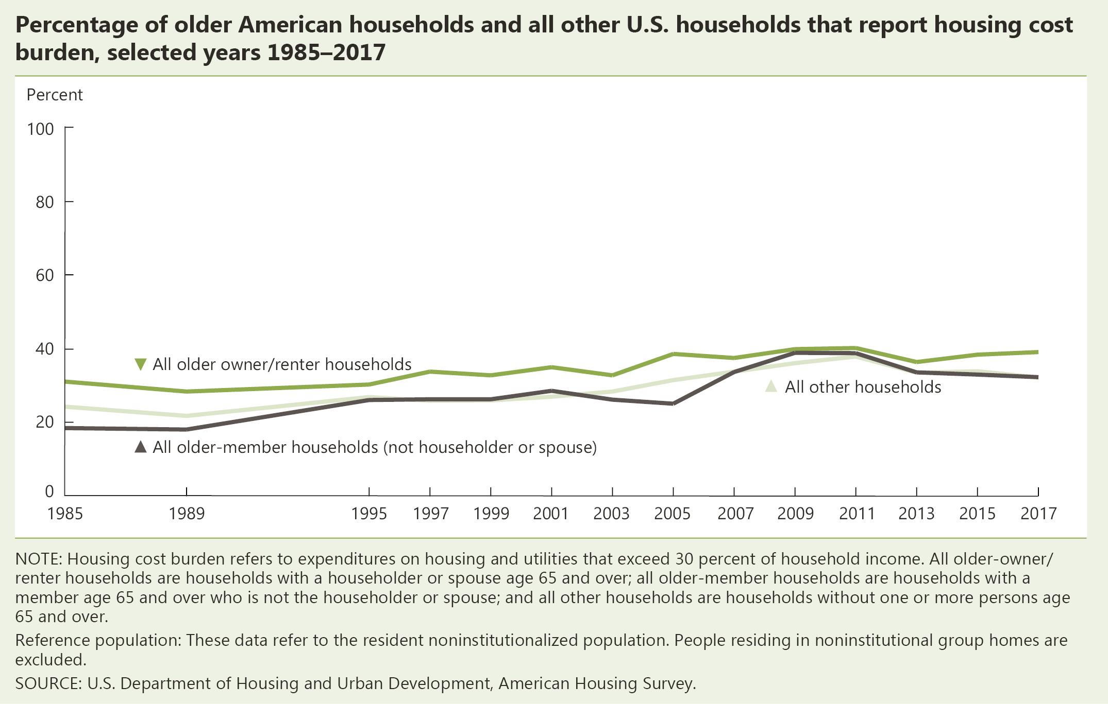
INDICATOR 12: Housing Problems

Slide 21
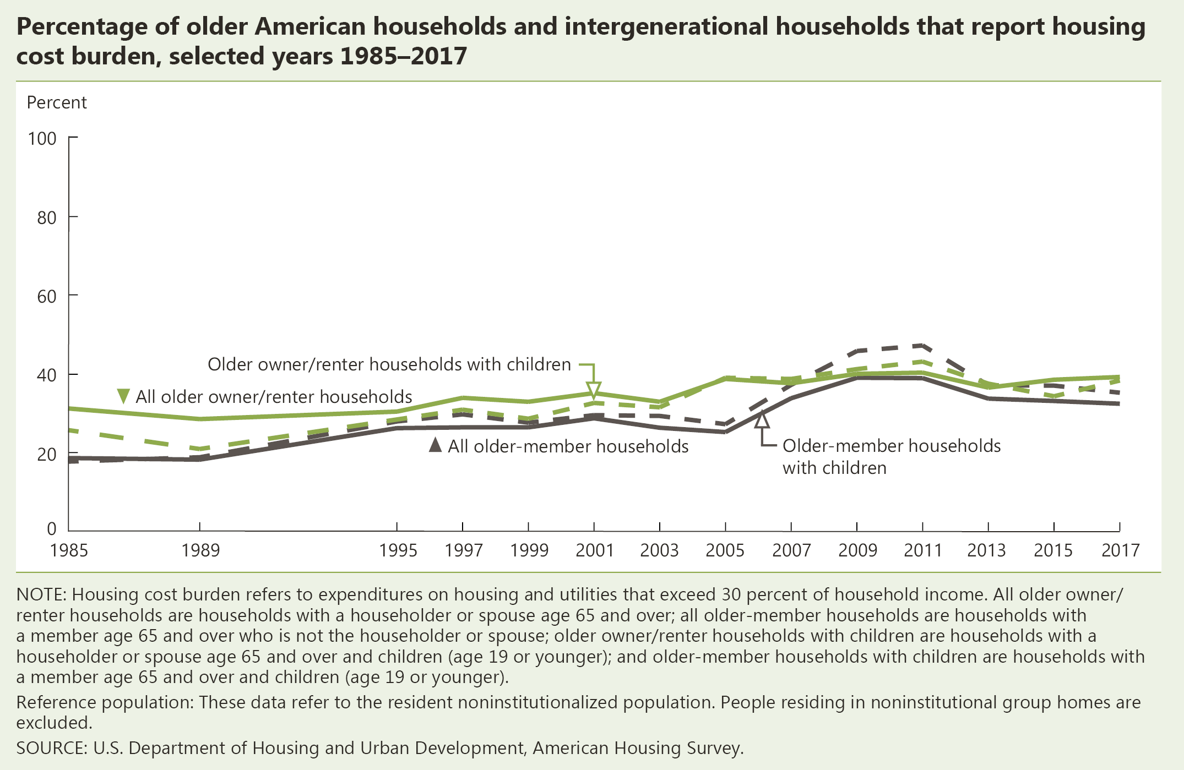
INDICATOR 12: Housing Problems (continued)

Slide 22
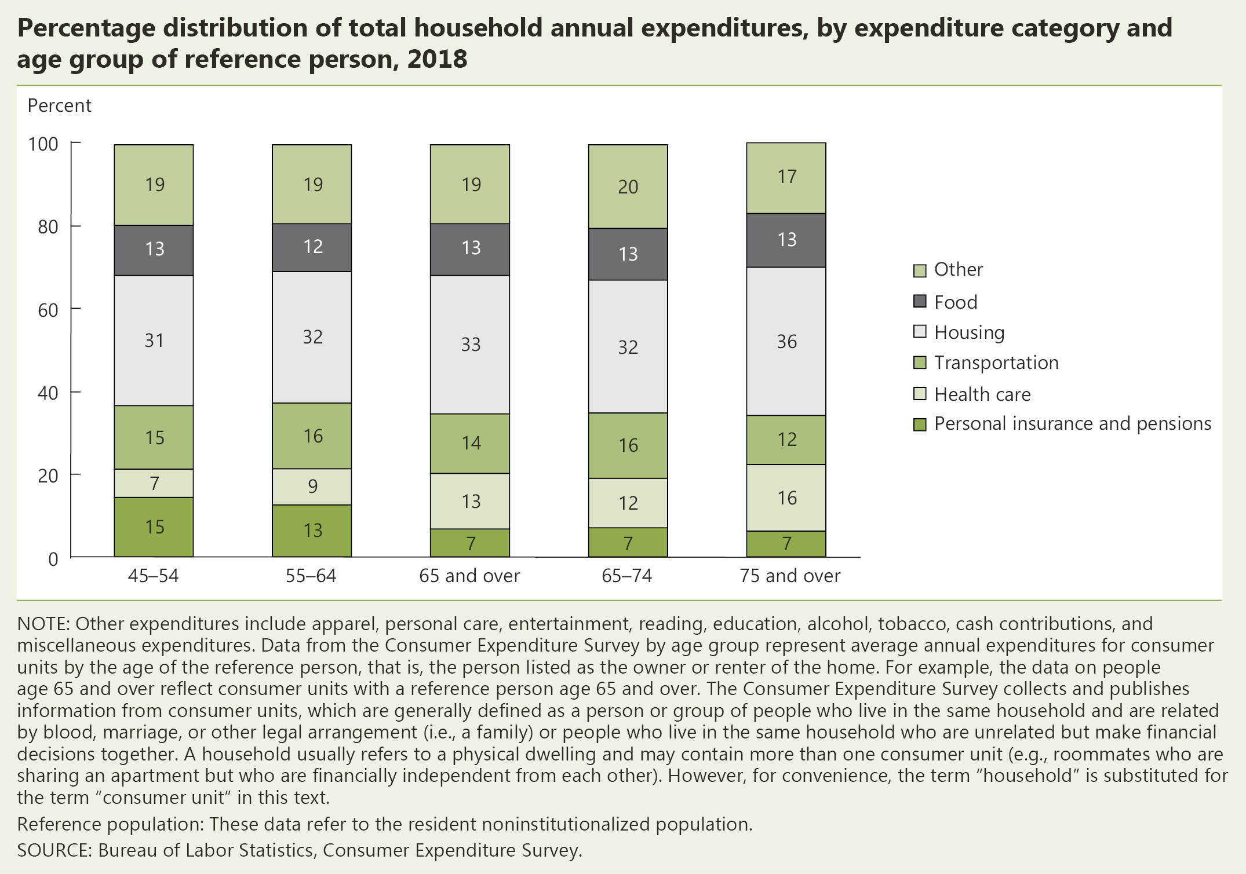
INDICATOR 13: Total Expenditures

Slide 24
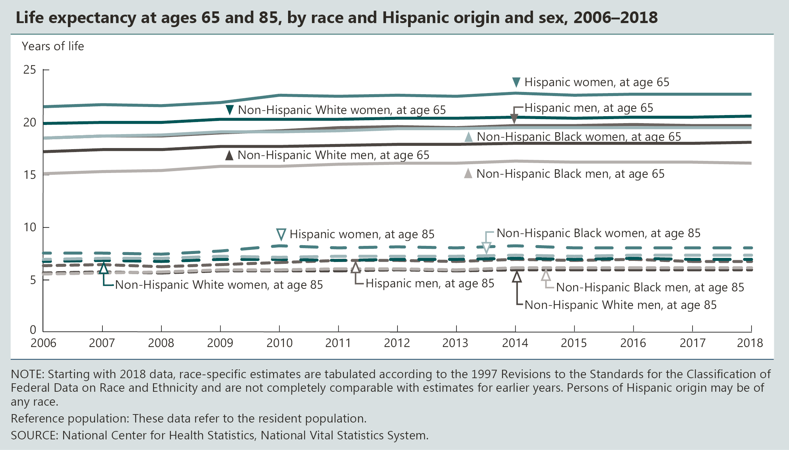
INDICATOR 14: Life Expectancy

Slide 25
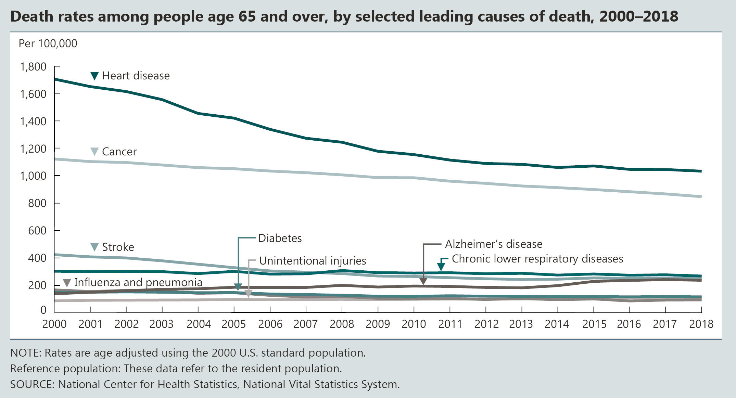
INDICATOR 15: Mortality

Slide 26
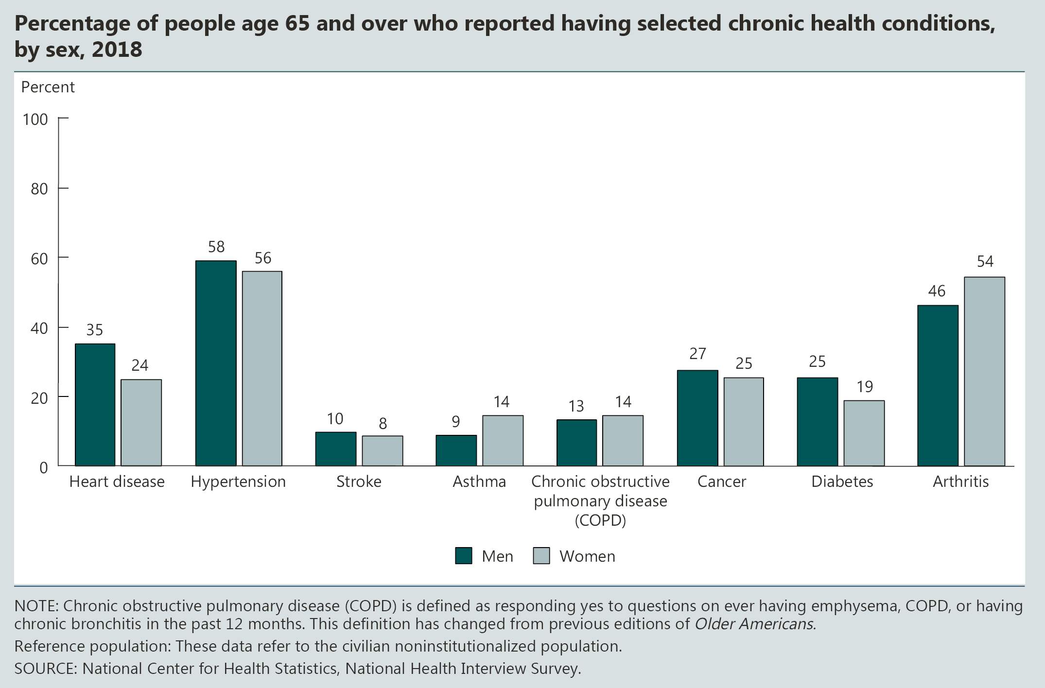
INDICATOR 16: Chronic Health Conditions

Slide 27
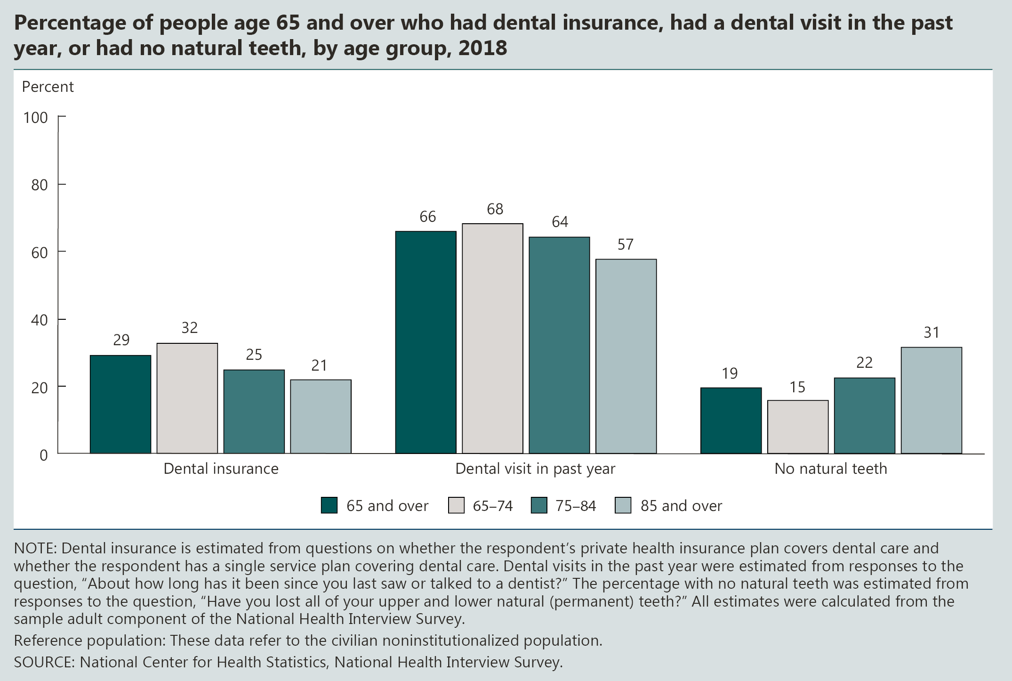
INDICATOR 17: Oral Health

Slide 28
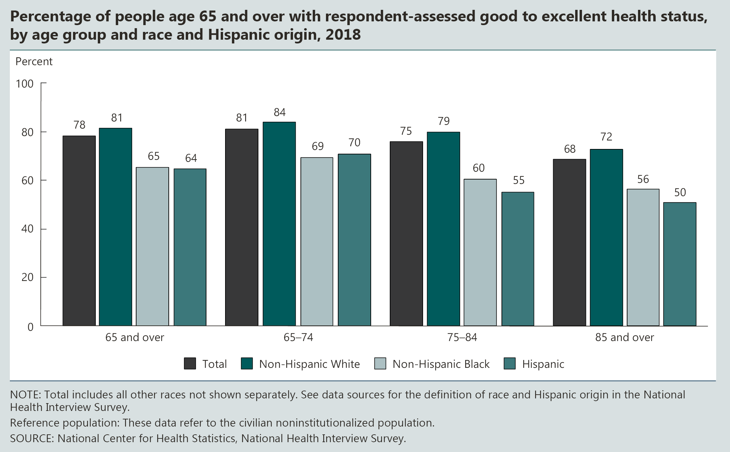
INDICATOR 18: Respondent-Assessed Health Status

Slide 29
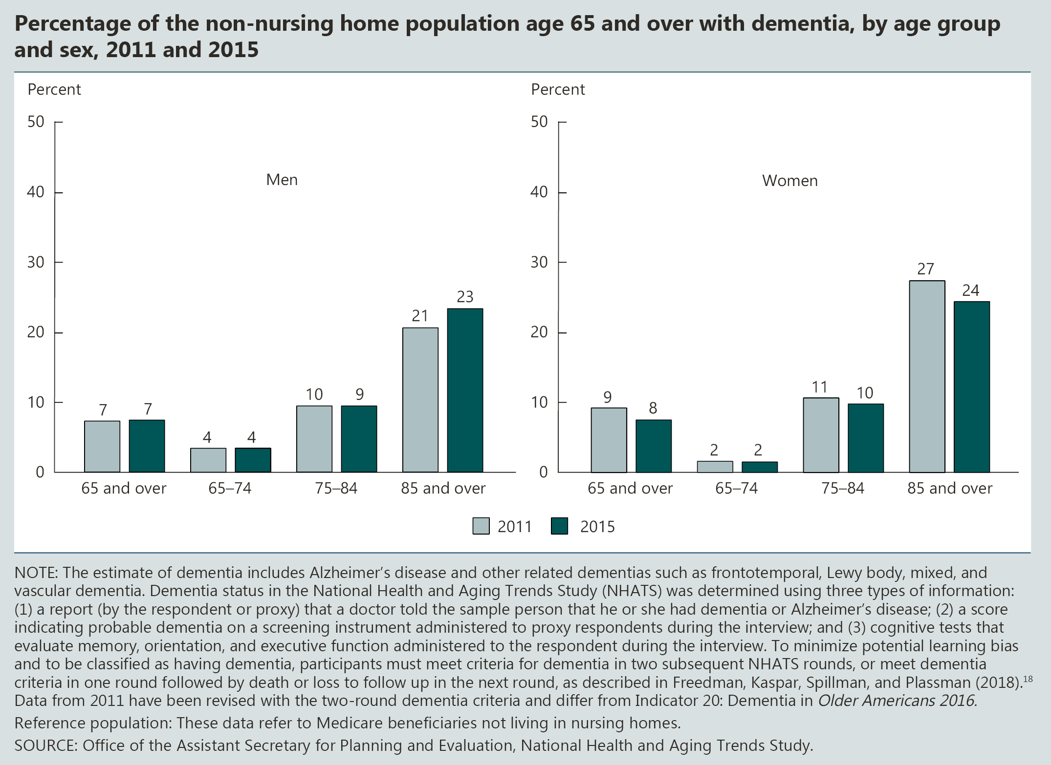
INDICATOR 19: Dementia

Slide 30
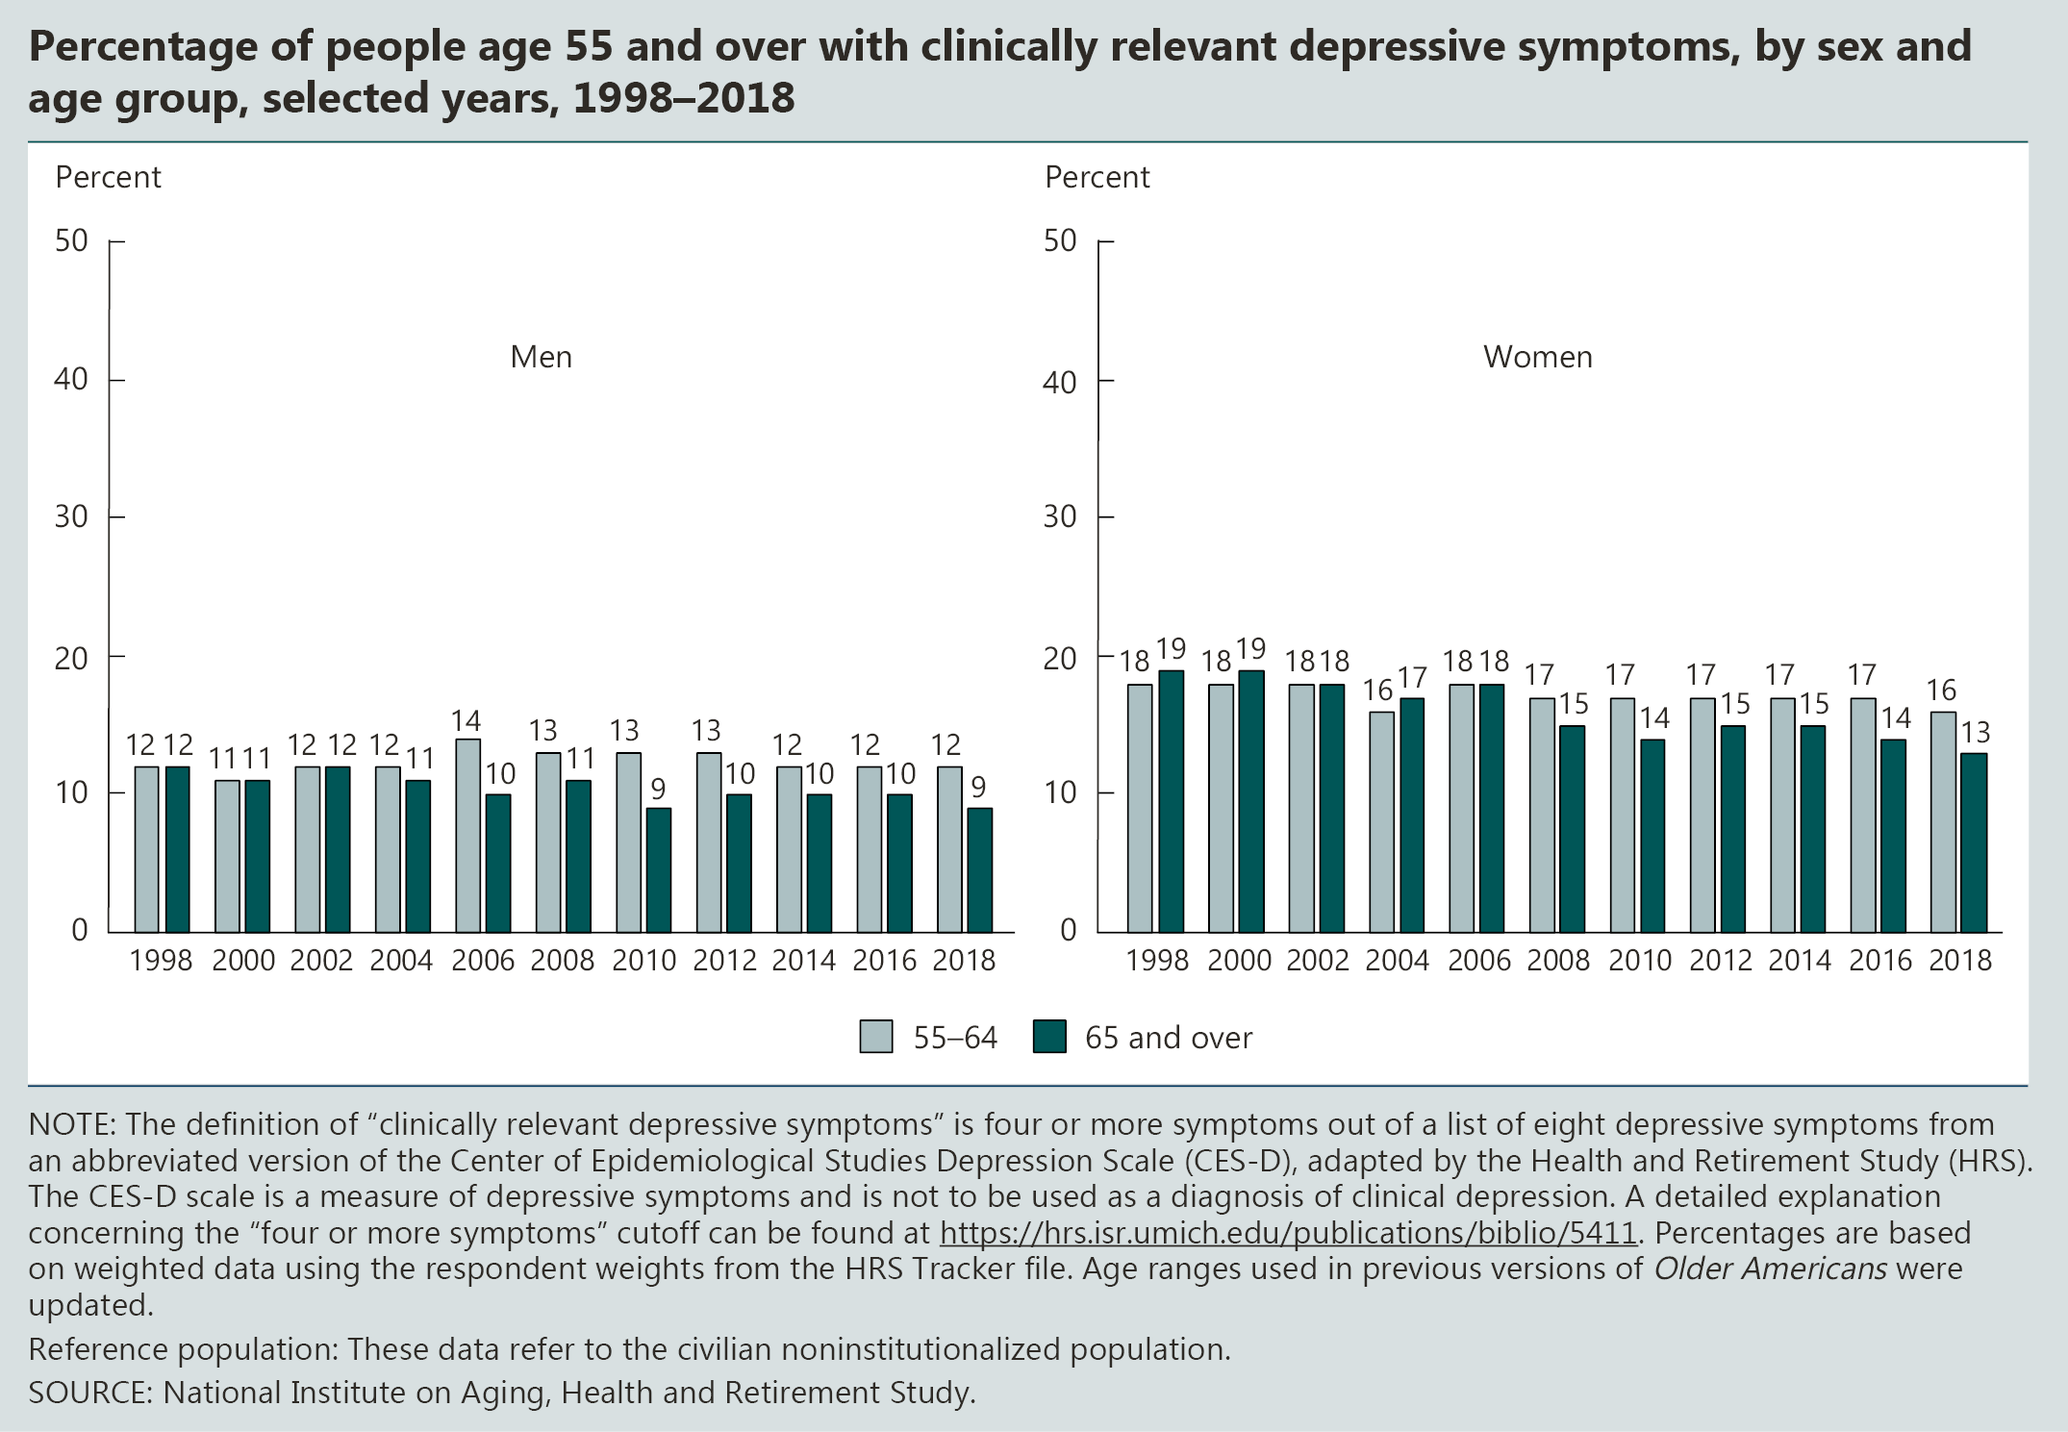
INDICATOR 20: Depressive Symptoms

Slide 31
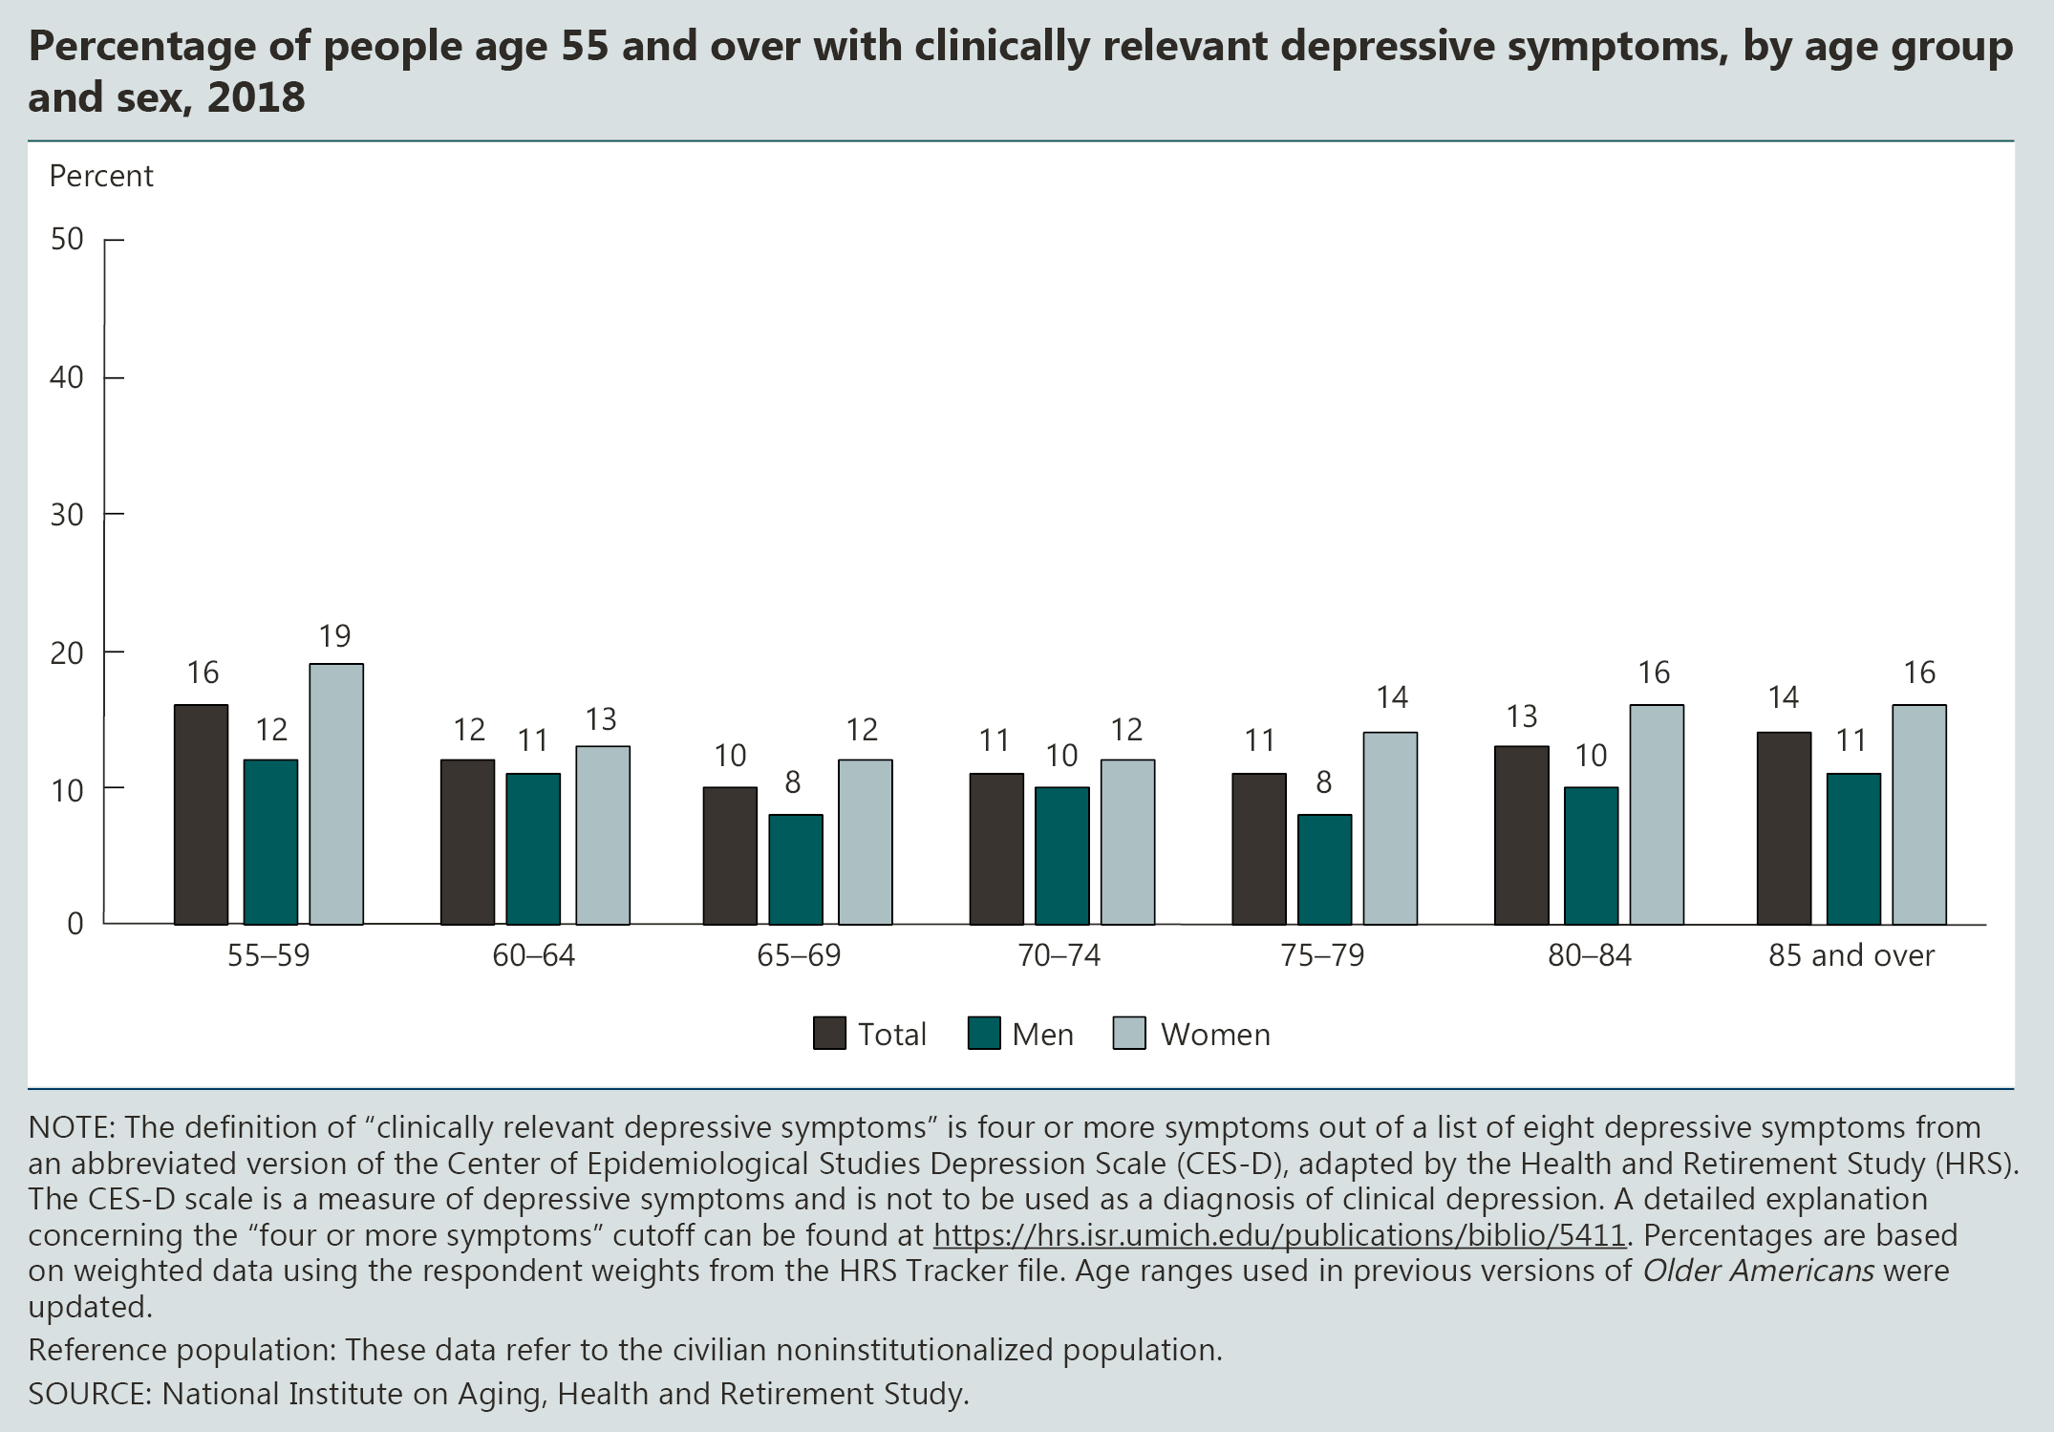
INDICATOR 20: Depressive Symptoms (continued)

Slide 32
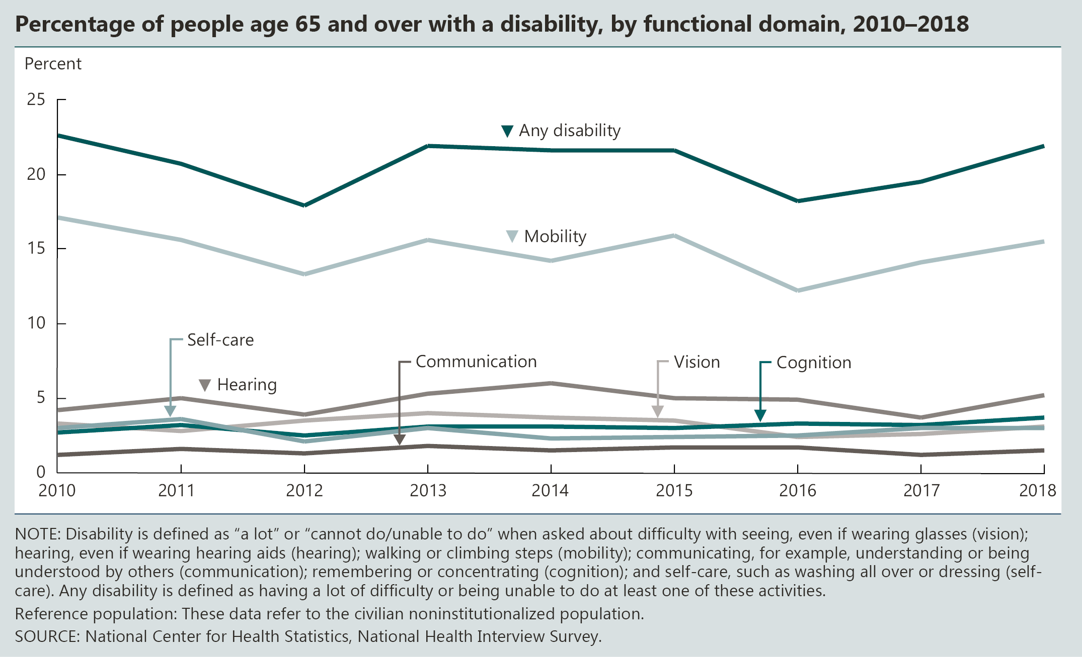
INDICATOR 21: Functional Limitations

Slide 33
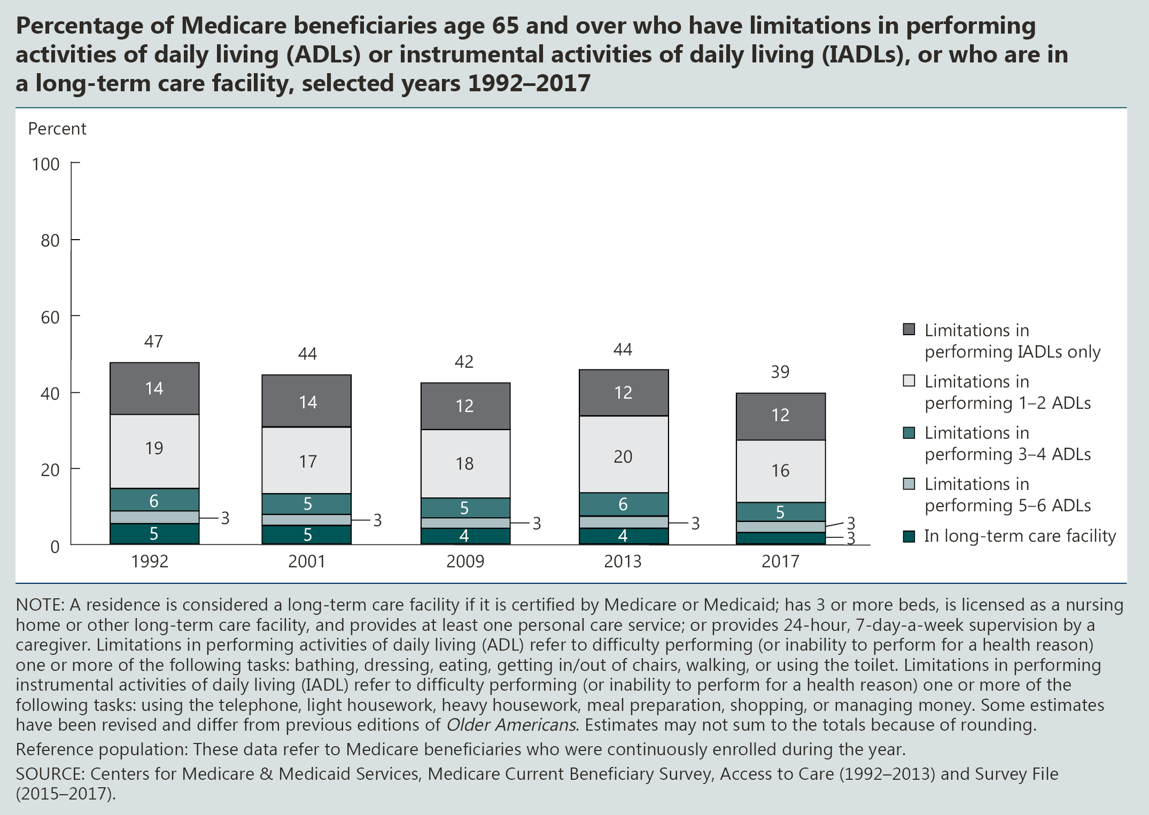
INDICATOR 21: Functional Limitations (continued)

Slide 35
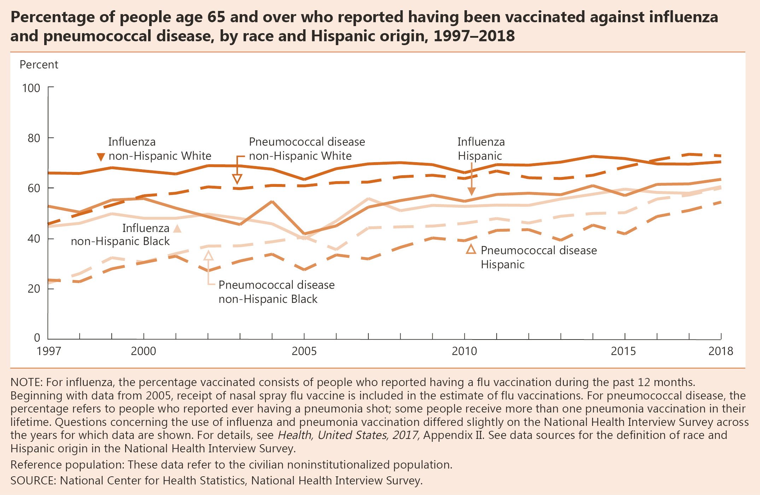
INDICATOR 22: Vaccinations

Slide 36
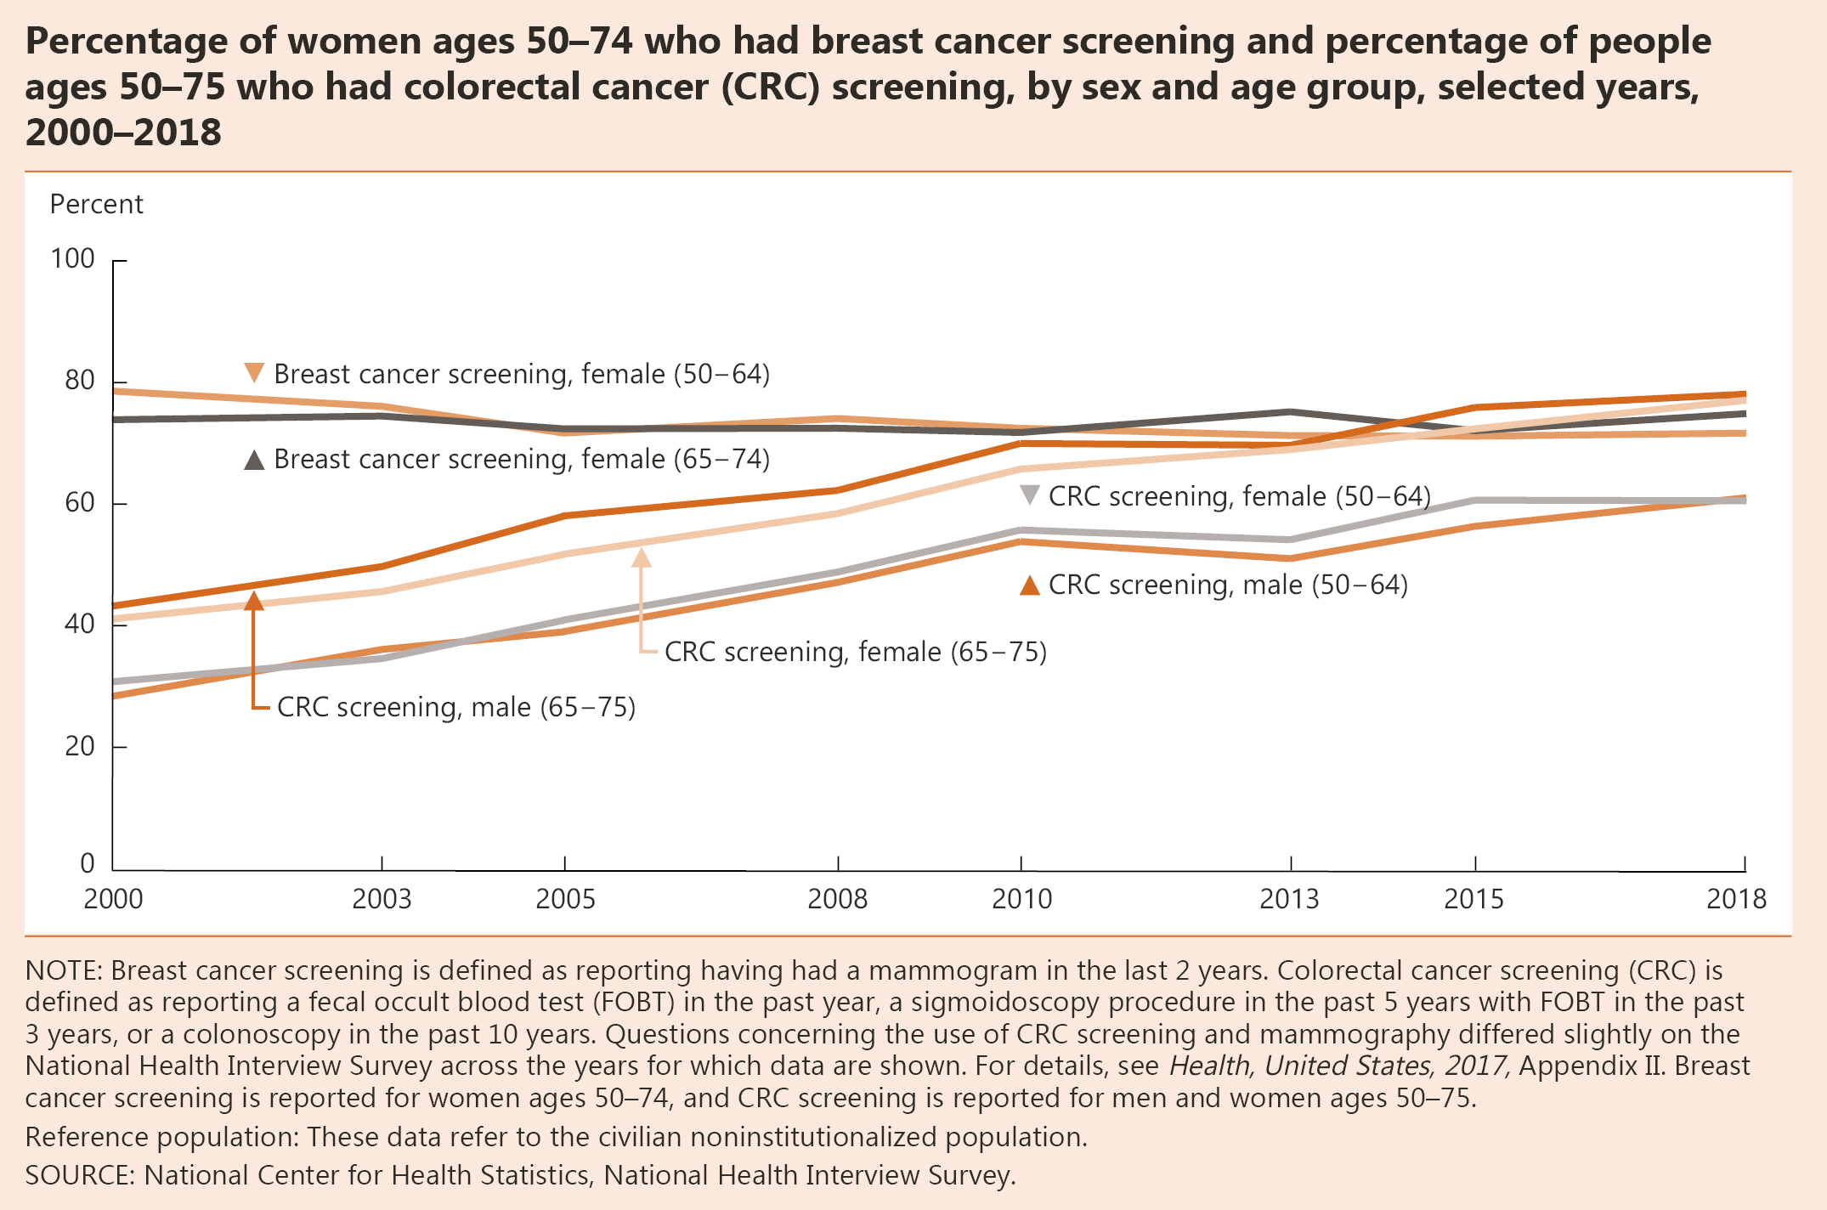
INDICATOR 23: Cancer Screenings

Slide 37
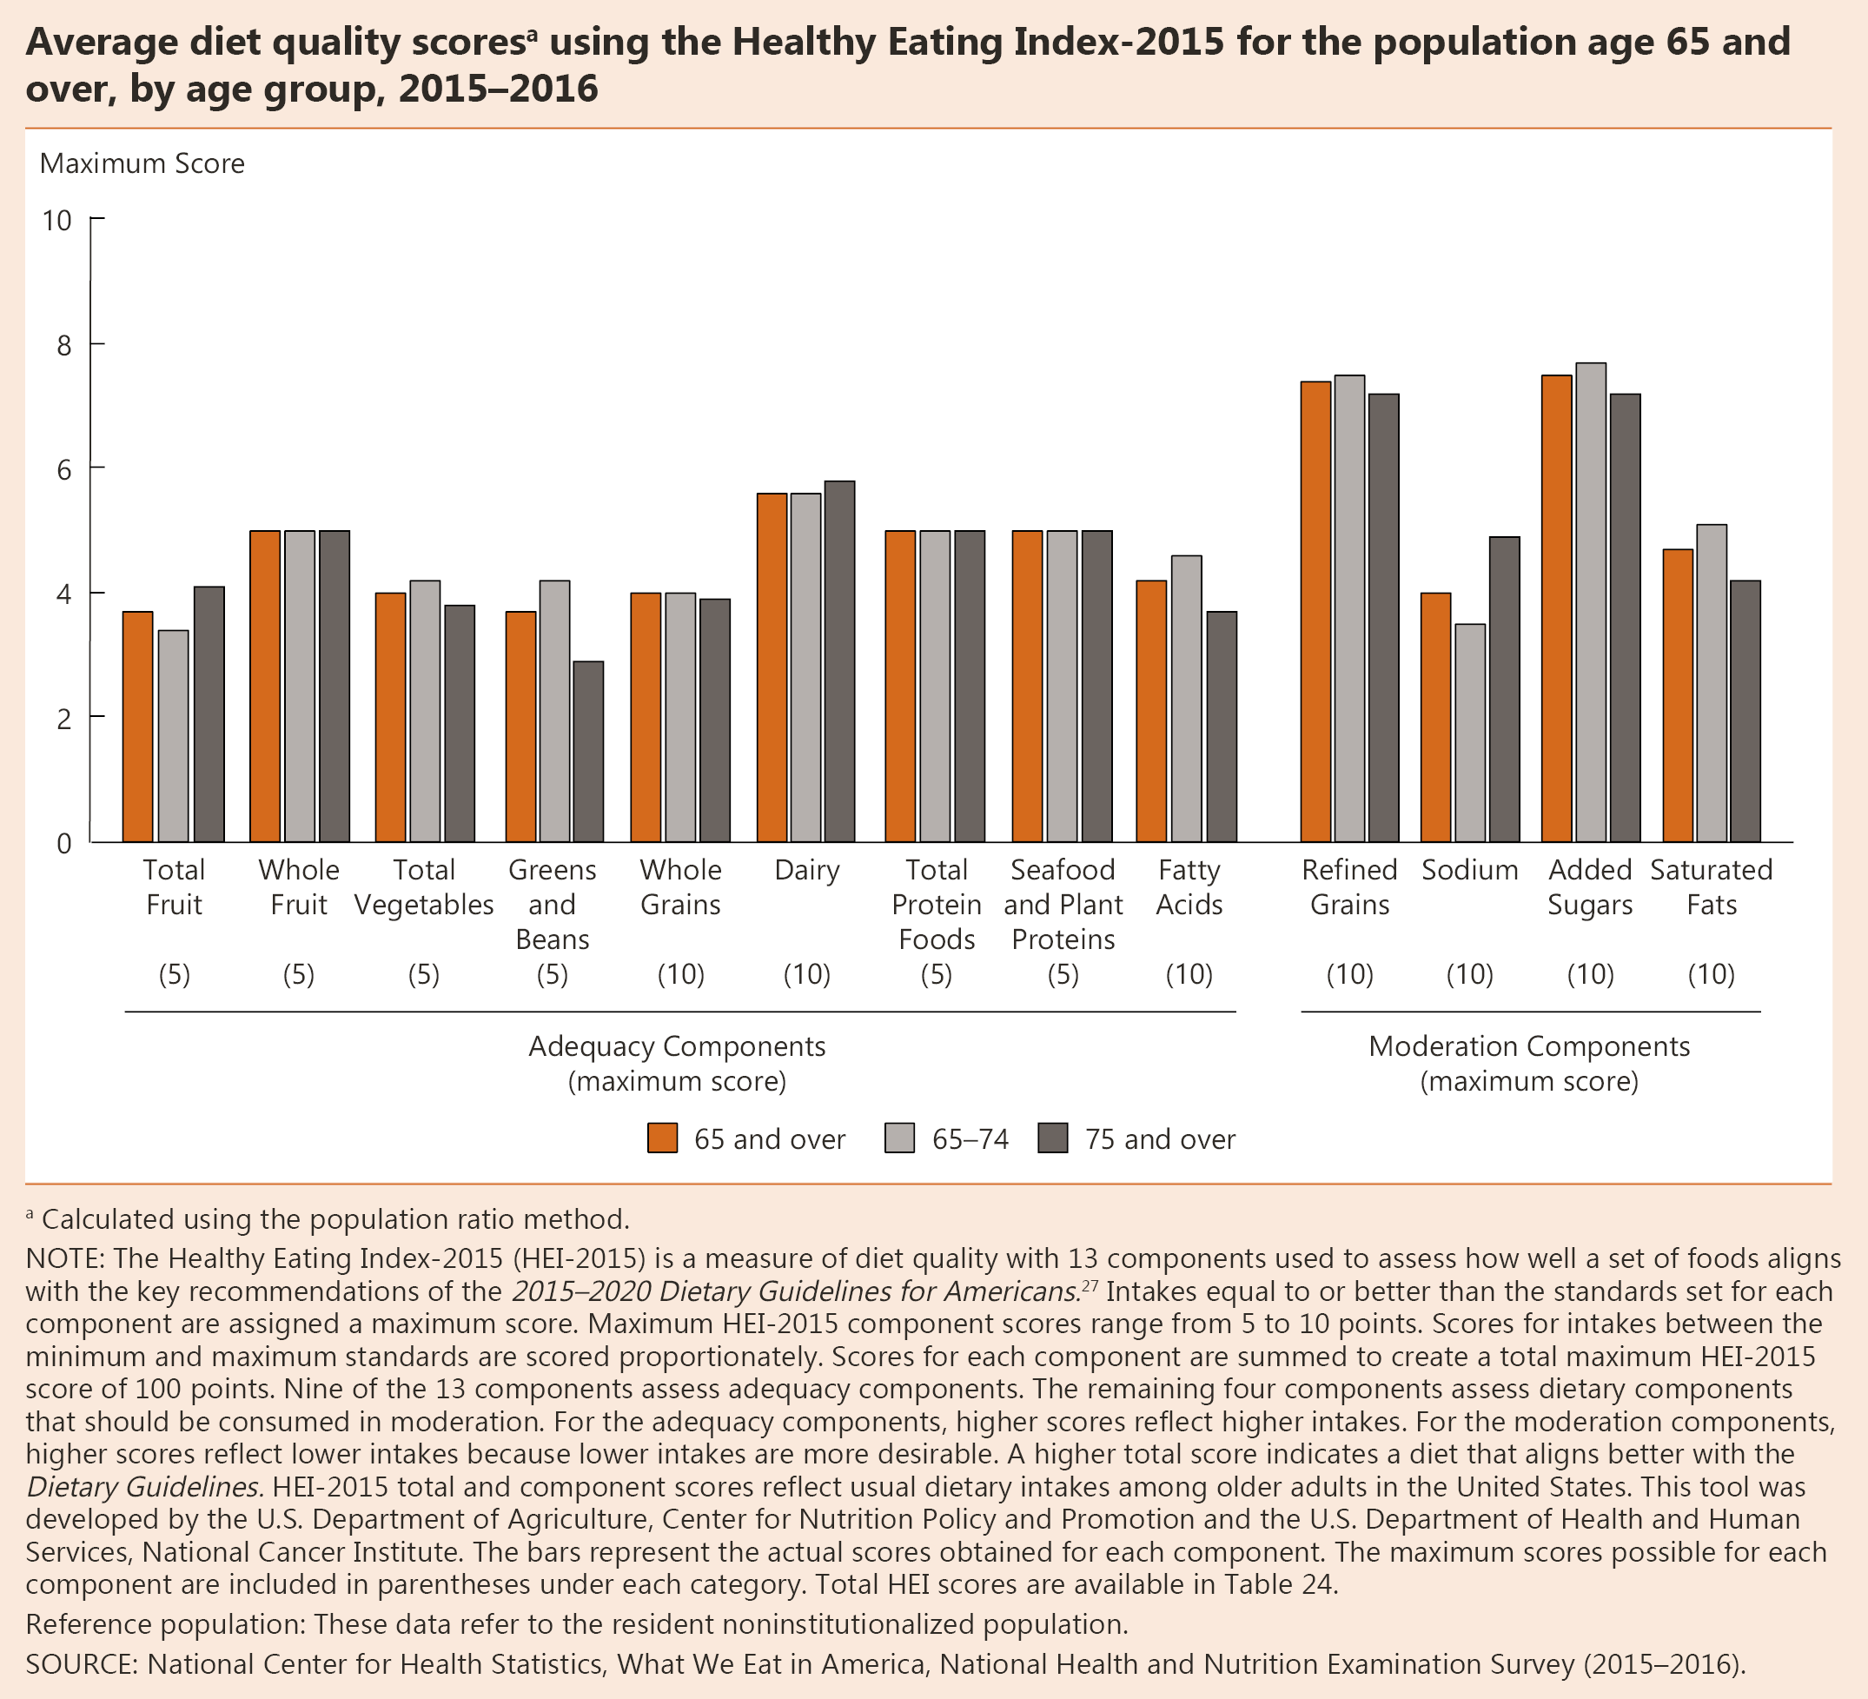
INDICATOR 24: Diet Quality

Slide 38
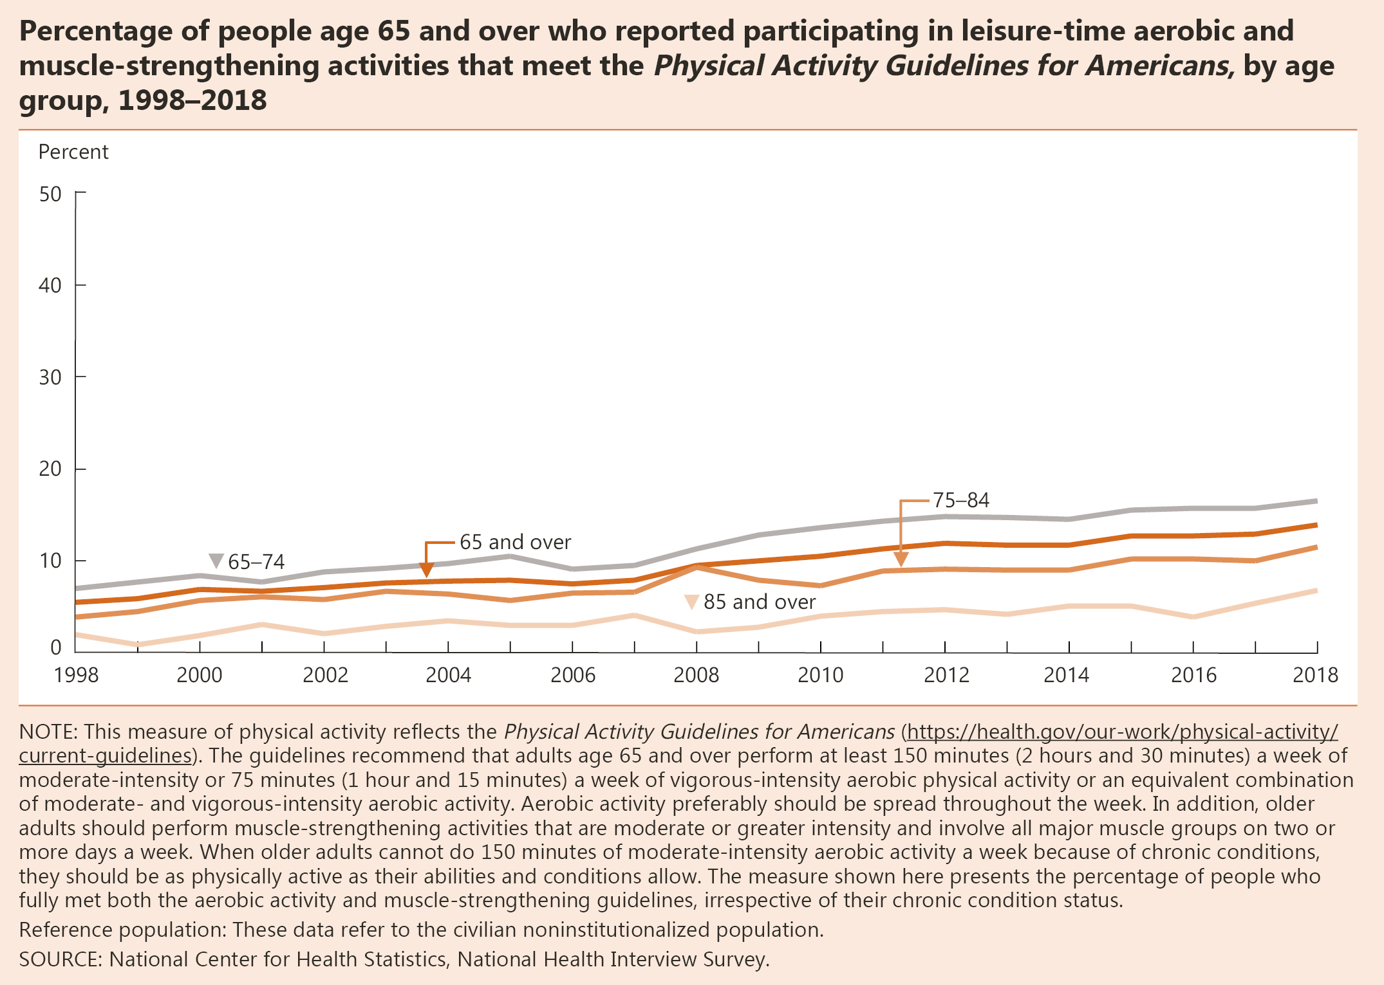
INDICATOR 25: Physical Activity

Slide 39
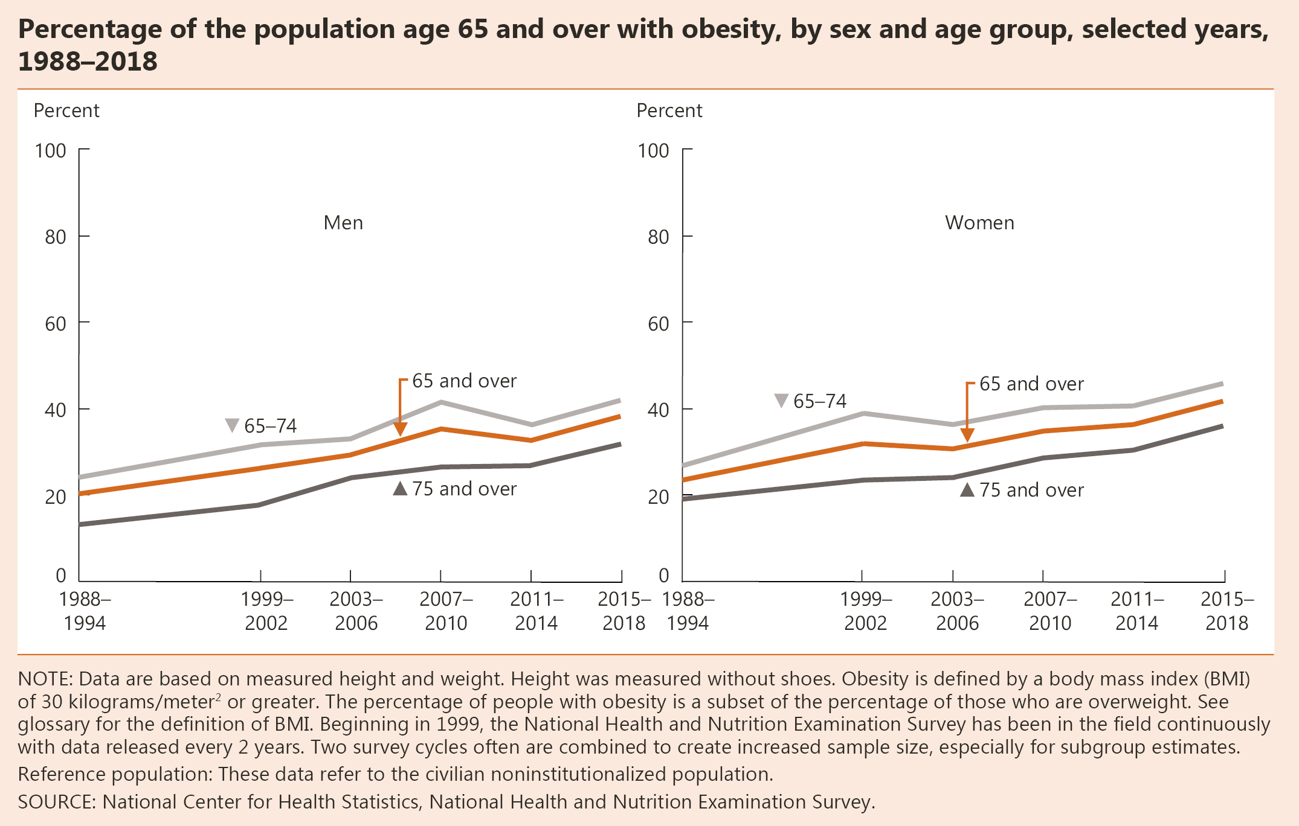
INDICATOR 26: Obesity

Slide 40
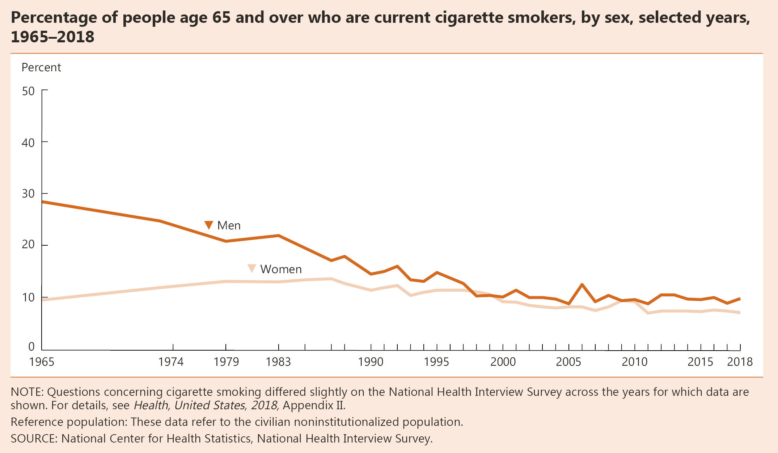
INDICATOR 27: Cigarette Smoking

Slide 42
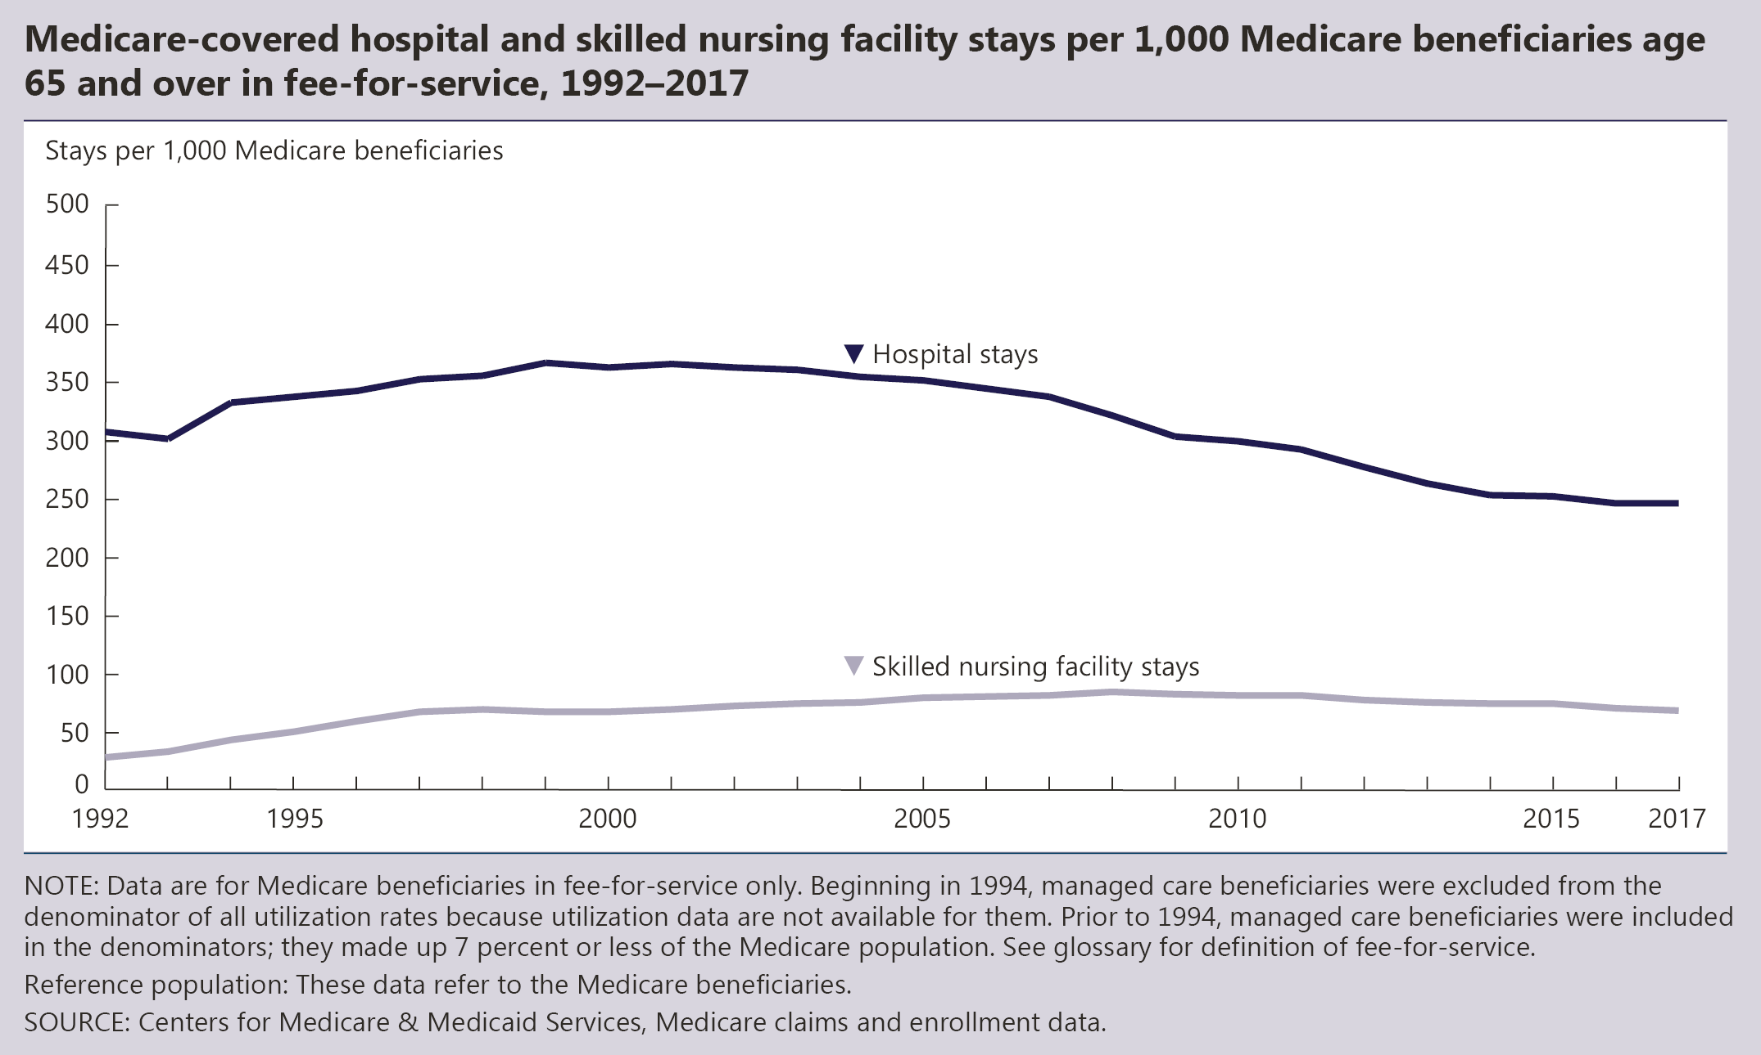
INDICATOR 28: Use of Health Care Services

Slide 43
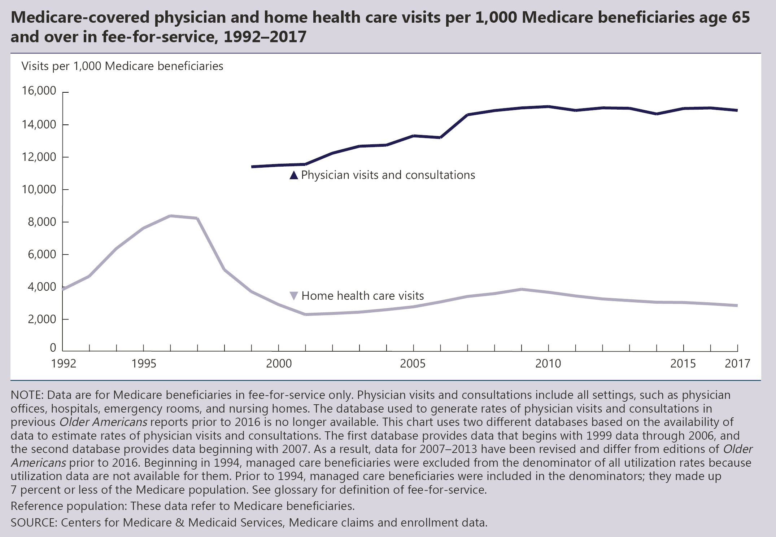
INDICATOR 28: Use of Health Care Services (continued)

Slide 44
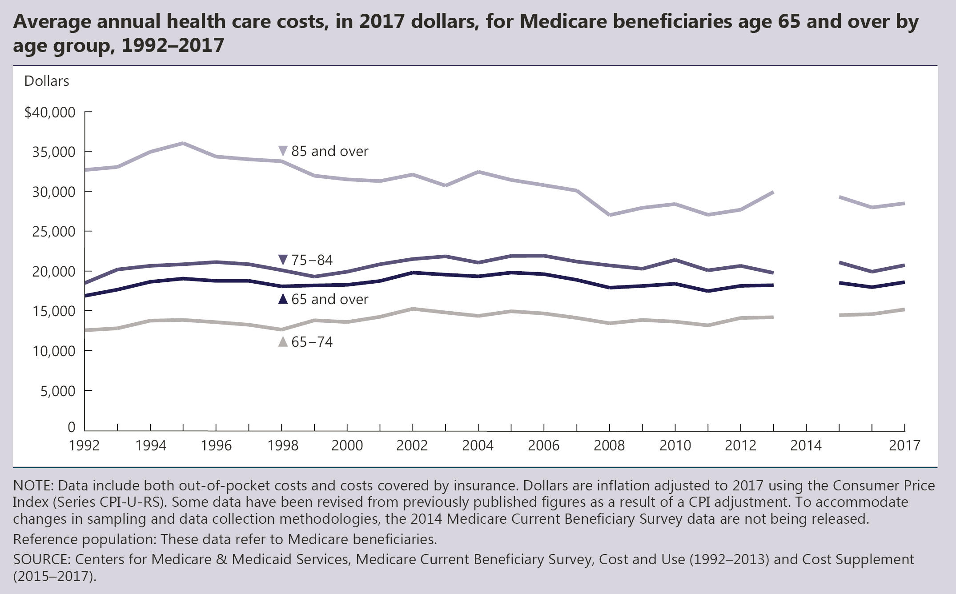
INDICATOR 29: Health Care Expenditures

Slide 45
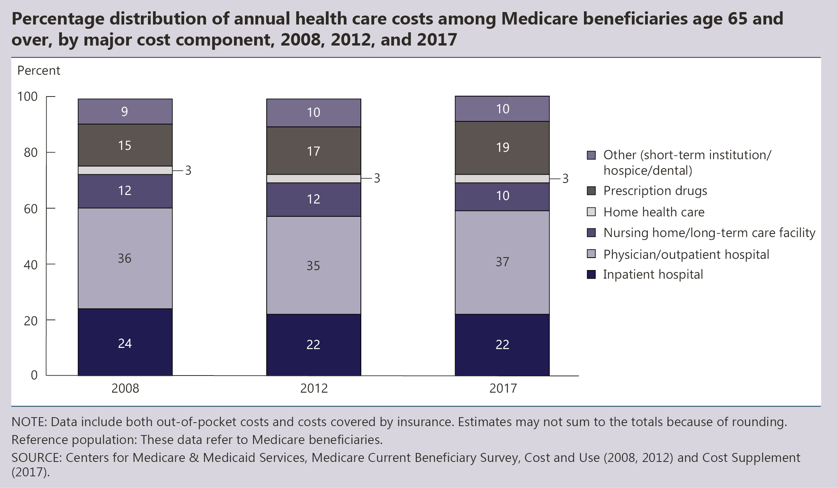
INDICATOR 29: Health Care Expenditures (continued)

Slide 46
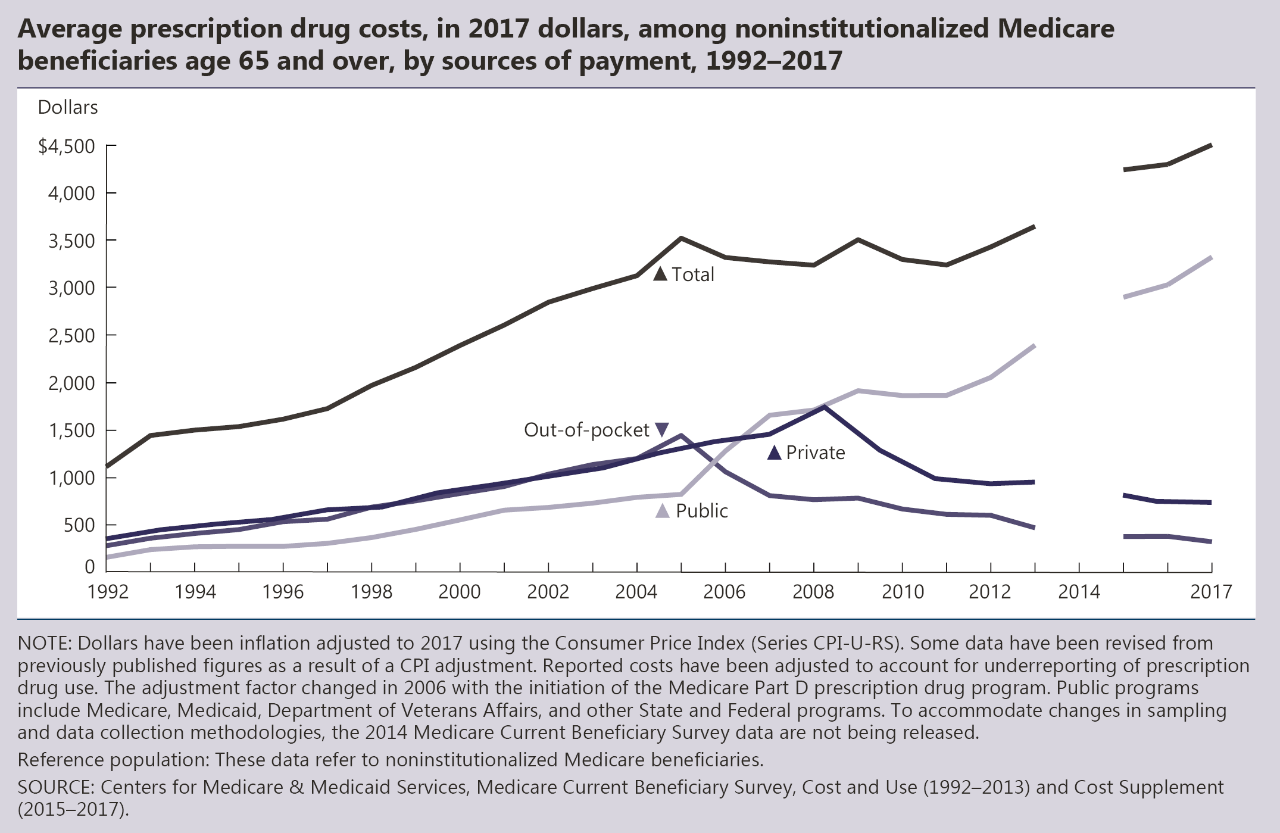
INDICATOR 30: Prescription Drugs

Slide 47
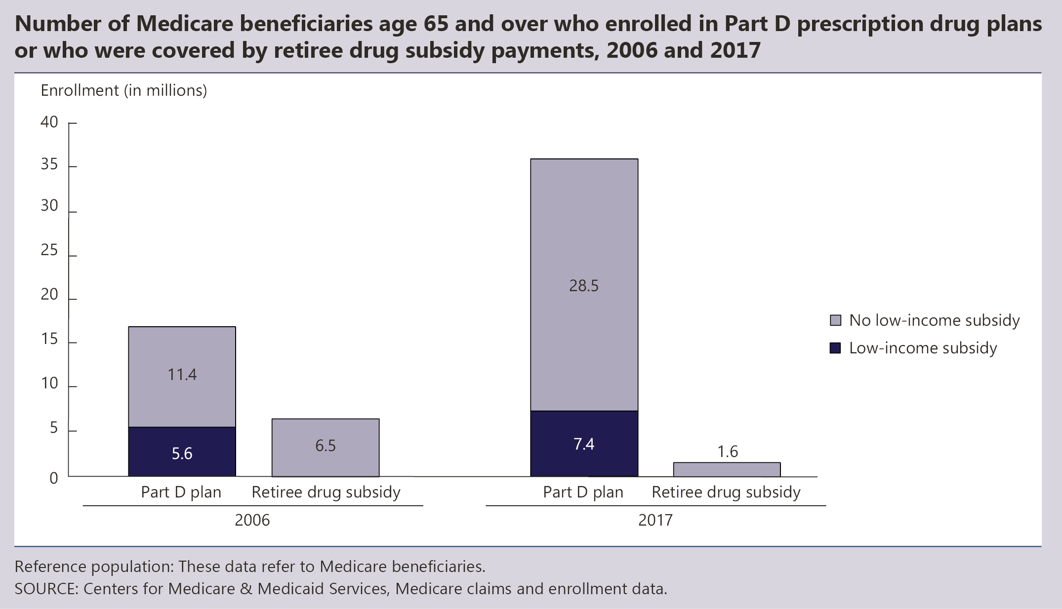
INDICATOR 30: Prescription Drugs (continued)

Slide 48
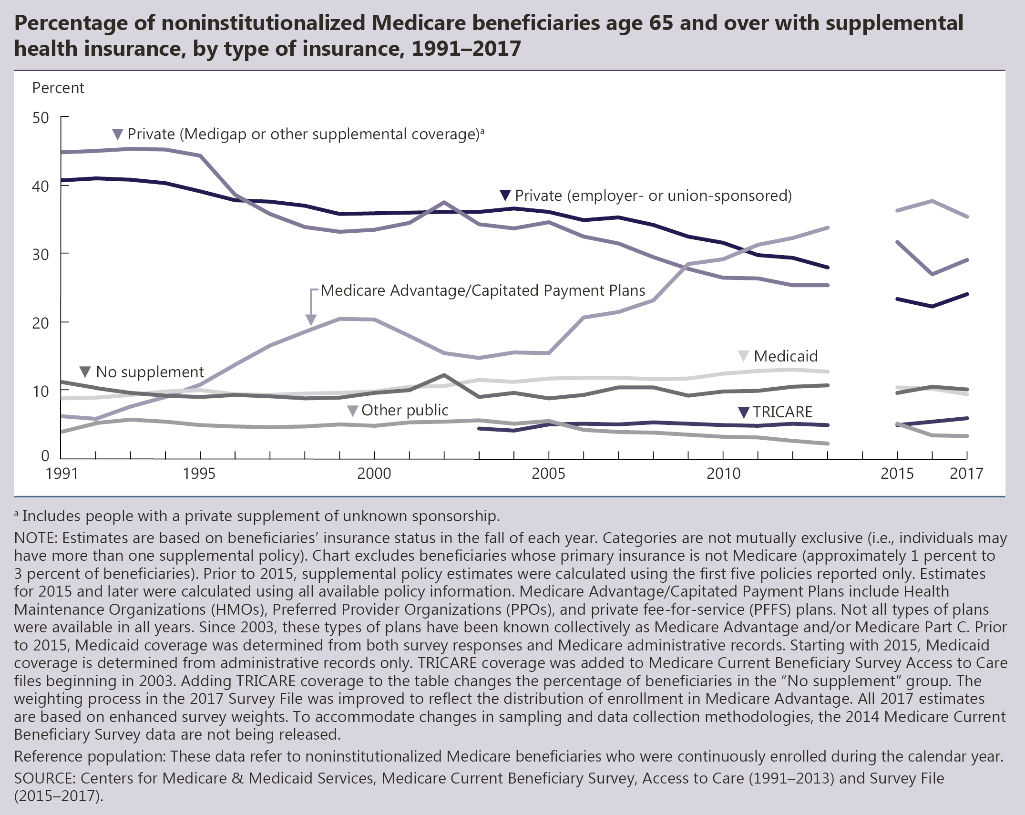
INDICATOR 31: Sources of Health Insurance

Slide 49
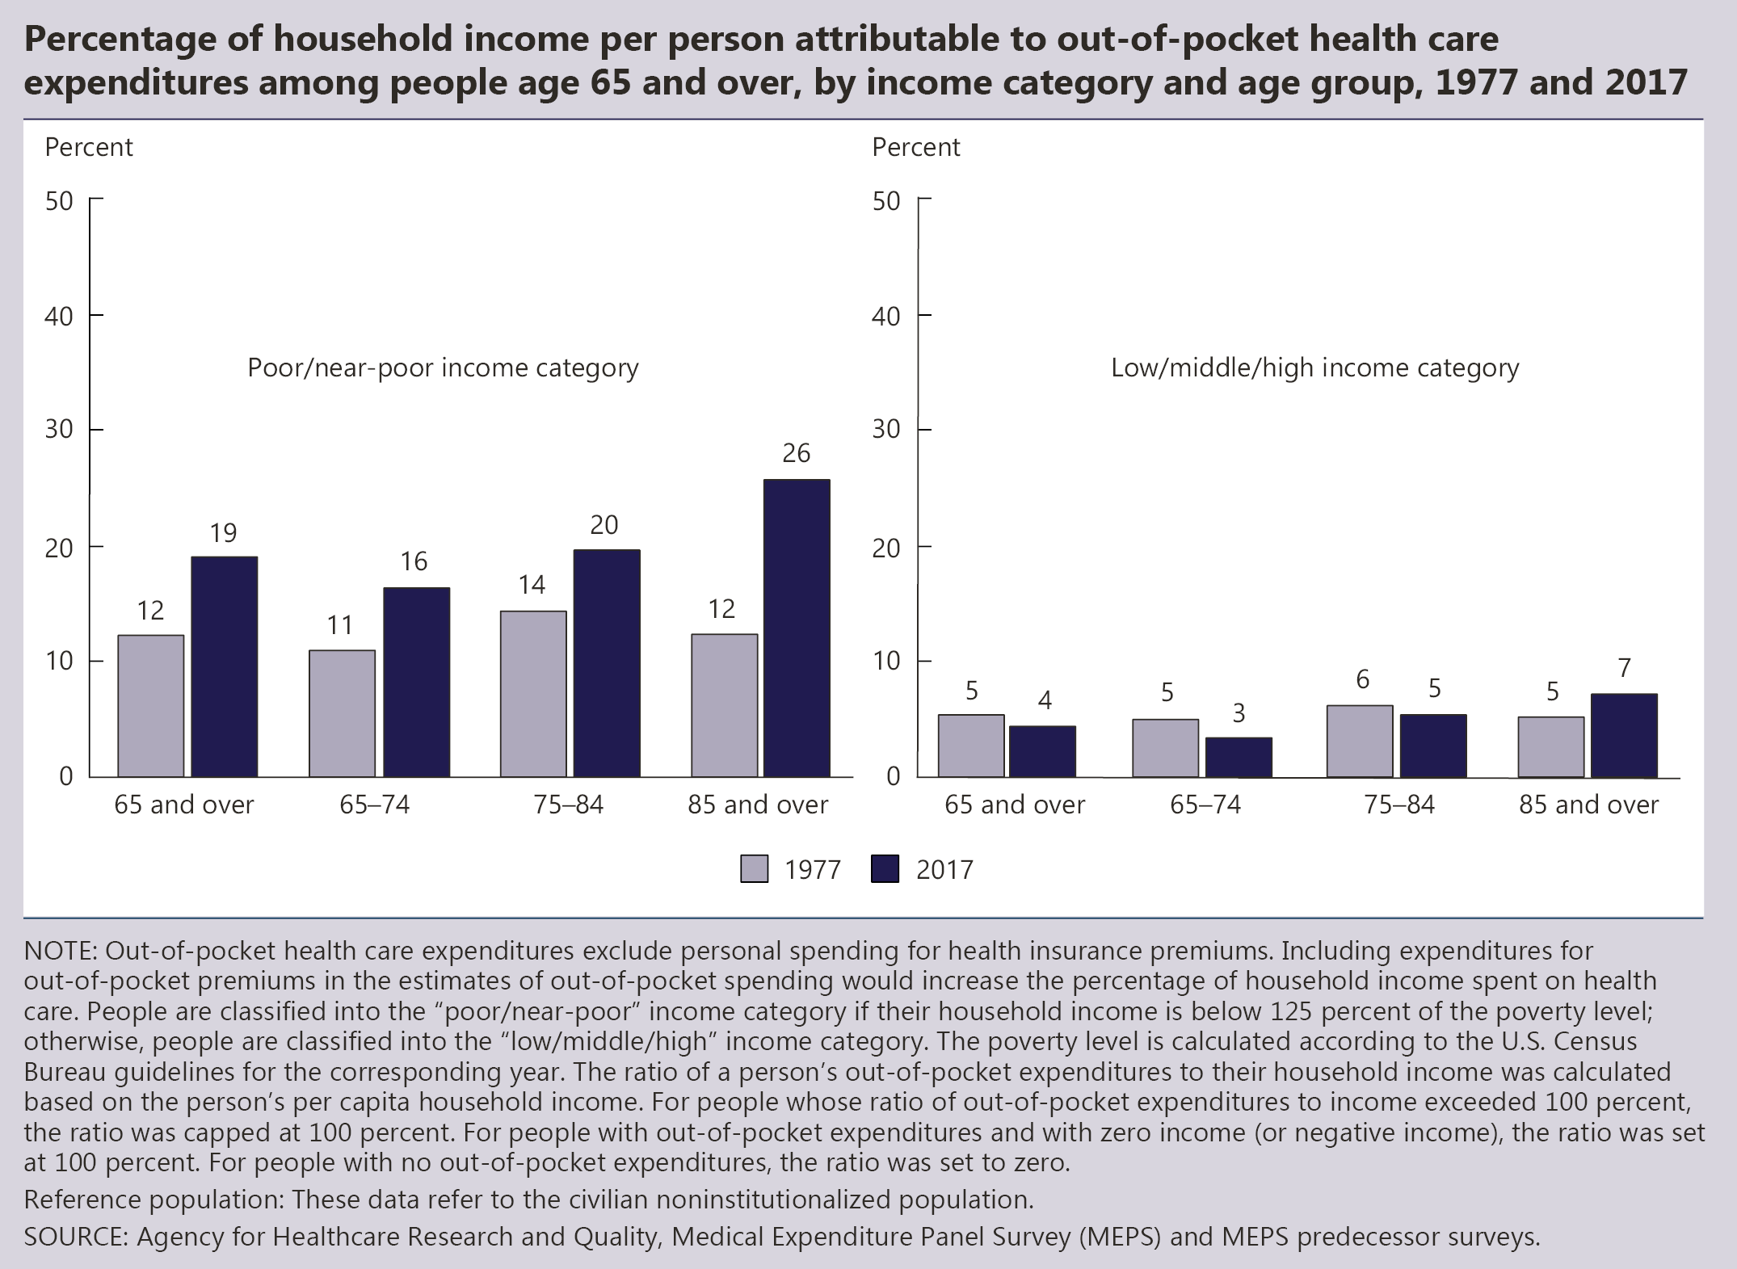
INDICATOR 32: Out-of-Pocket Health Care Expenditures

Slide 50
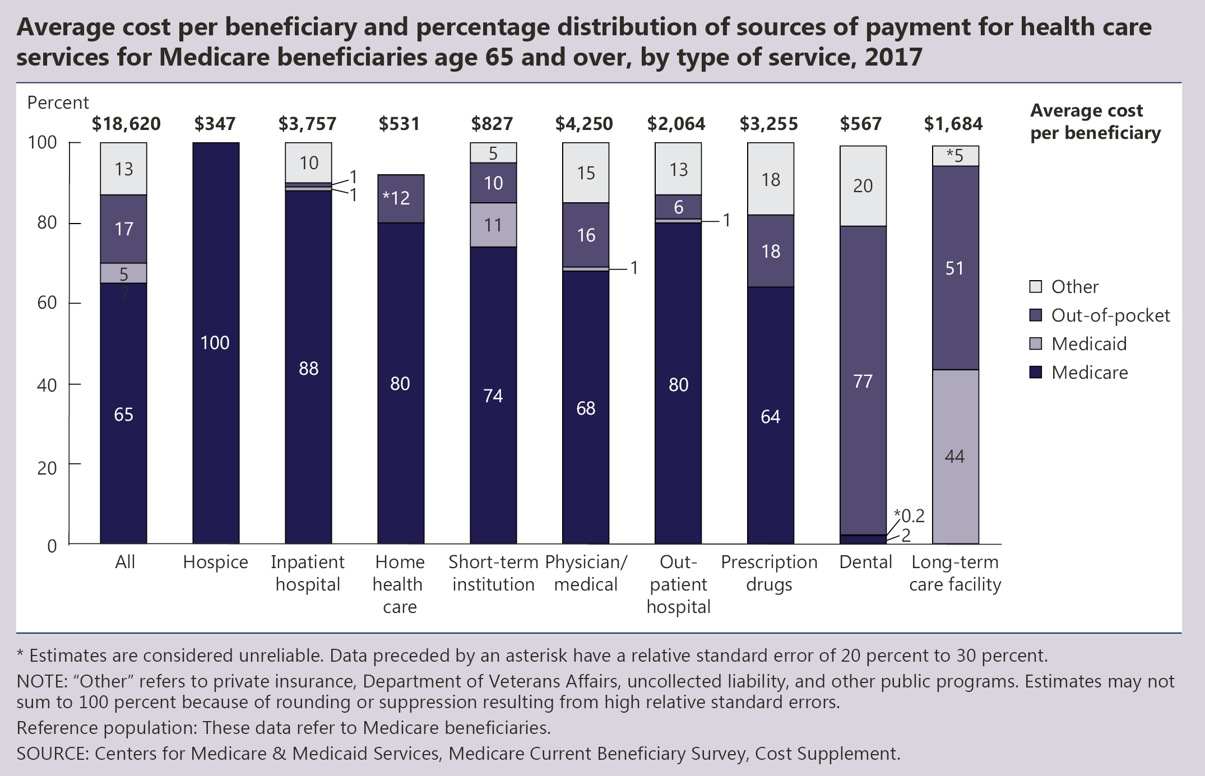
INDICATOR 33: Sources of Payment for Health Care Services

Slide 51
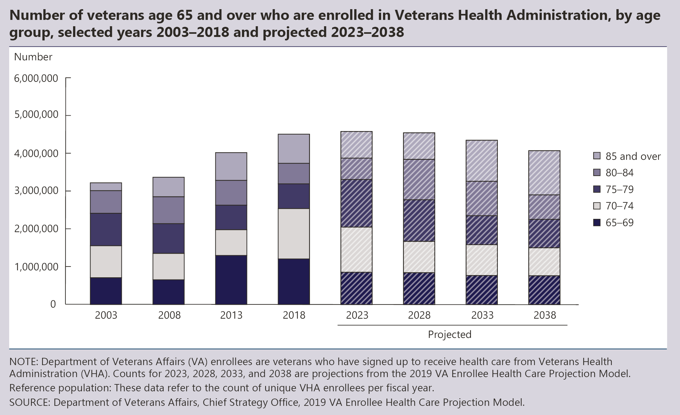
INDICATOR 34: Veterans’ Health Care

Slide 52
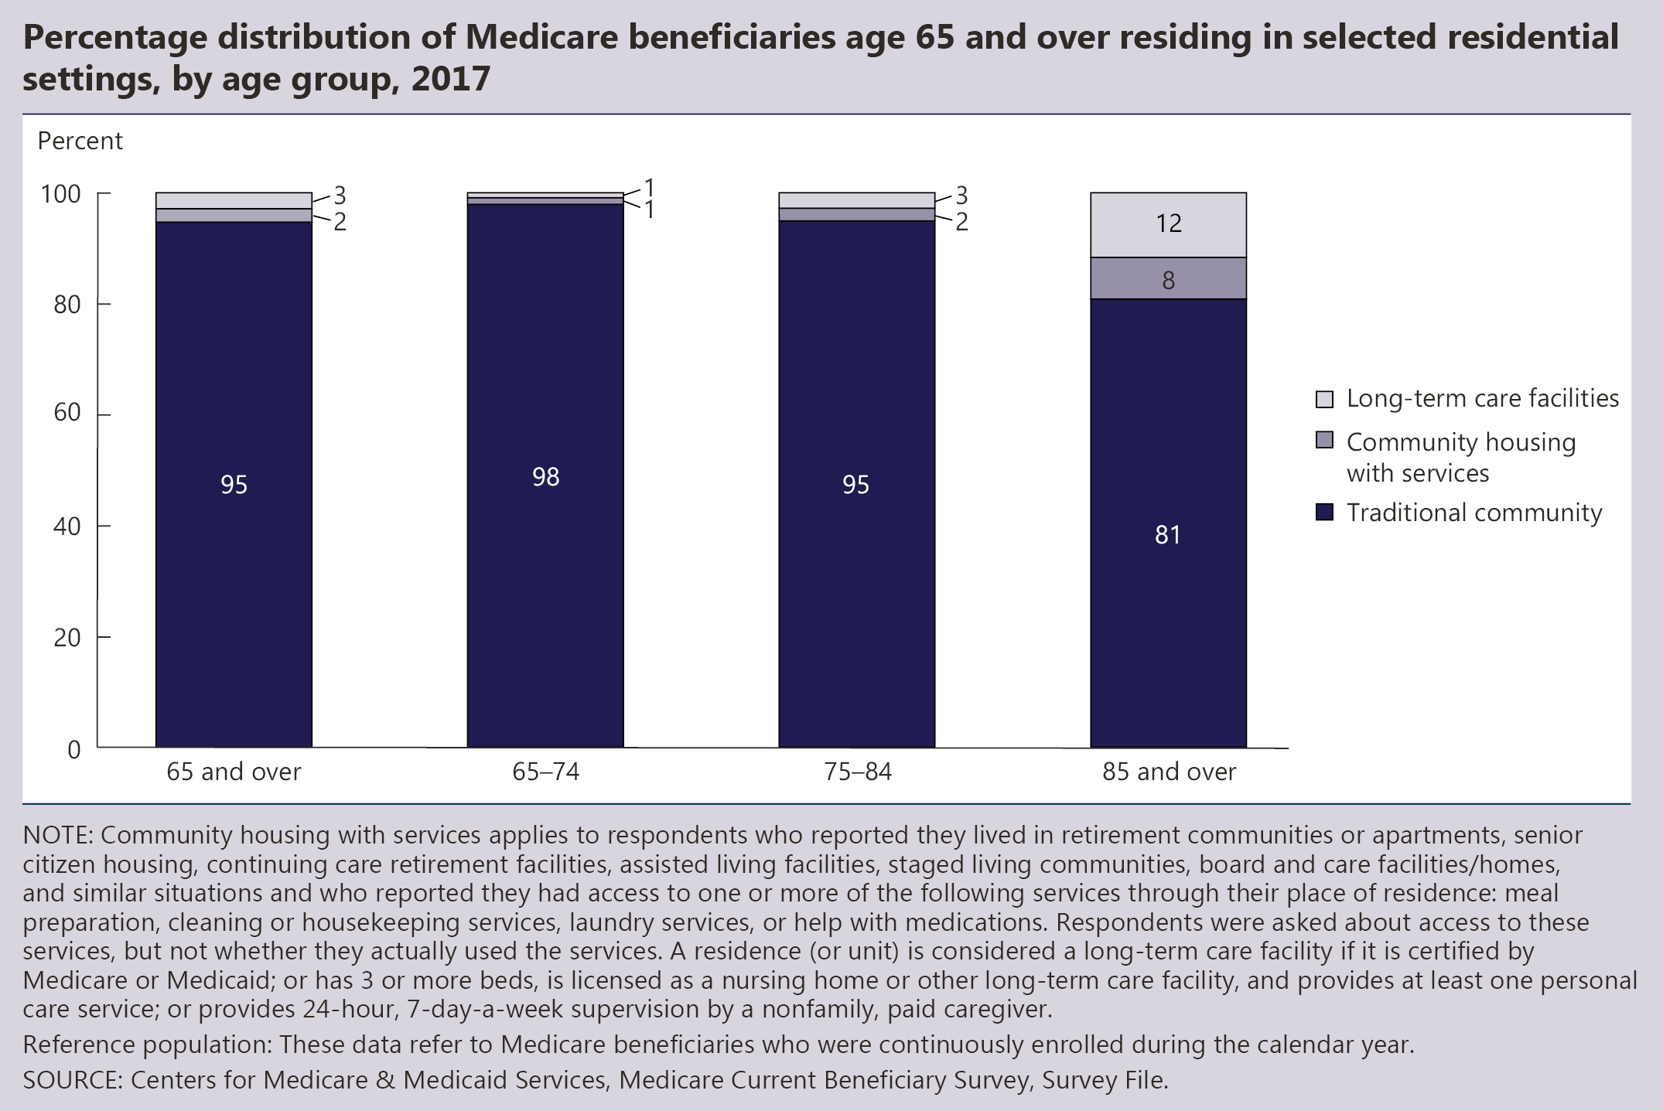
INDICATOR 35: Residential Services

Slide 53
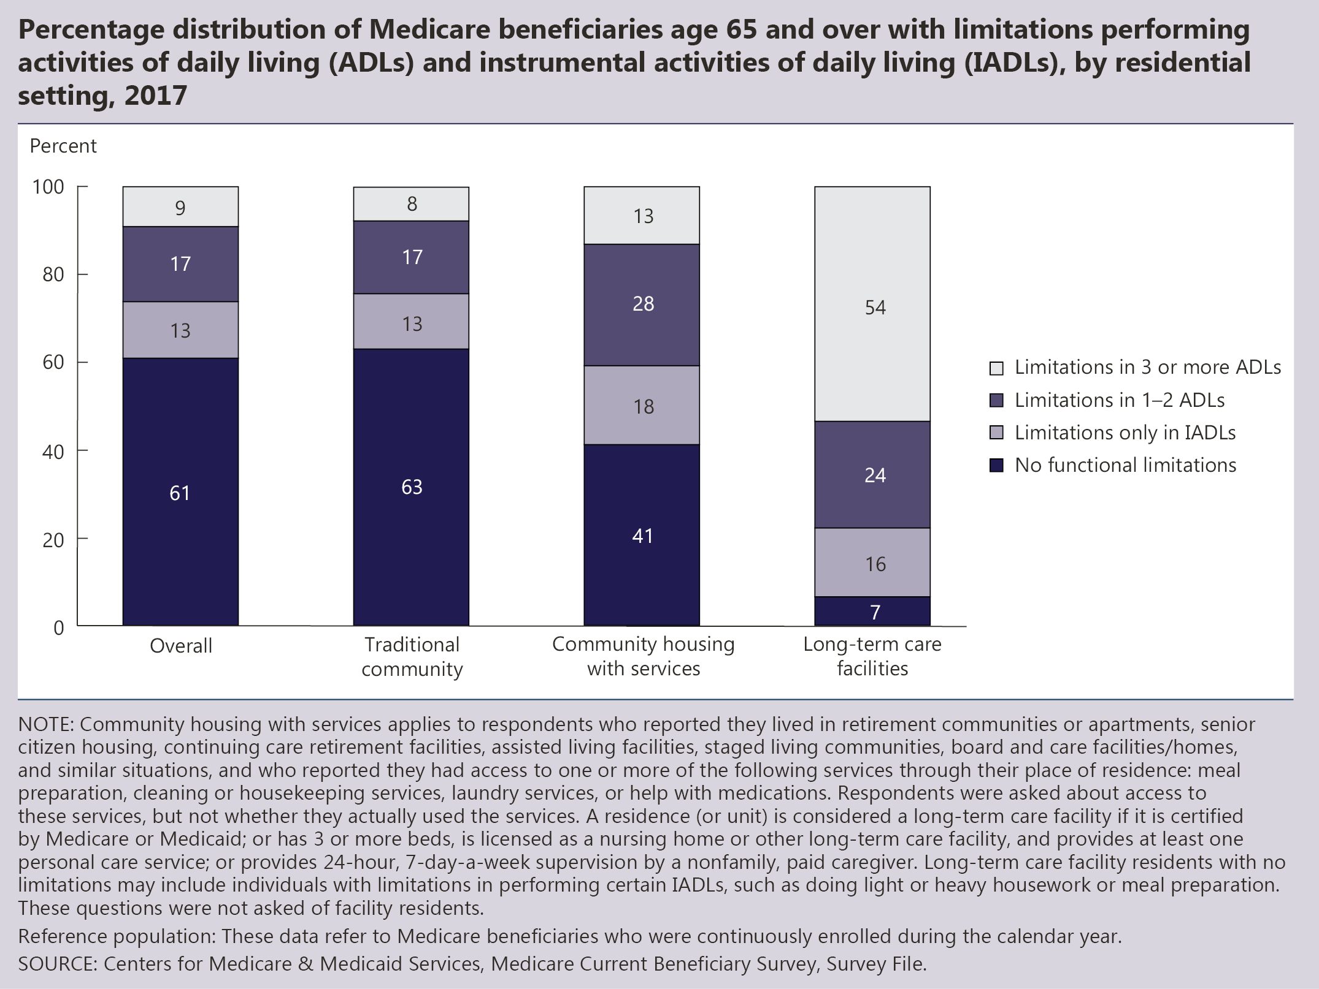
INDICATOR 35: Residential Services (continued)

Slide 54
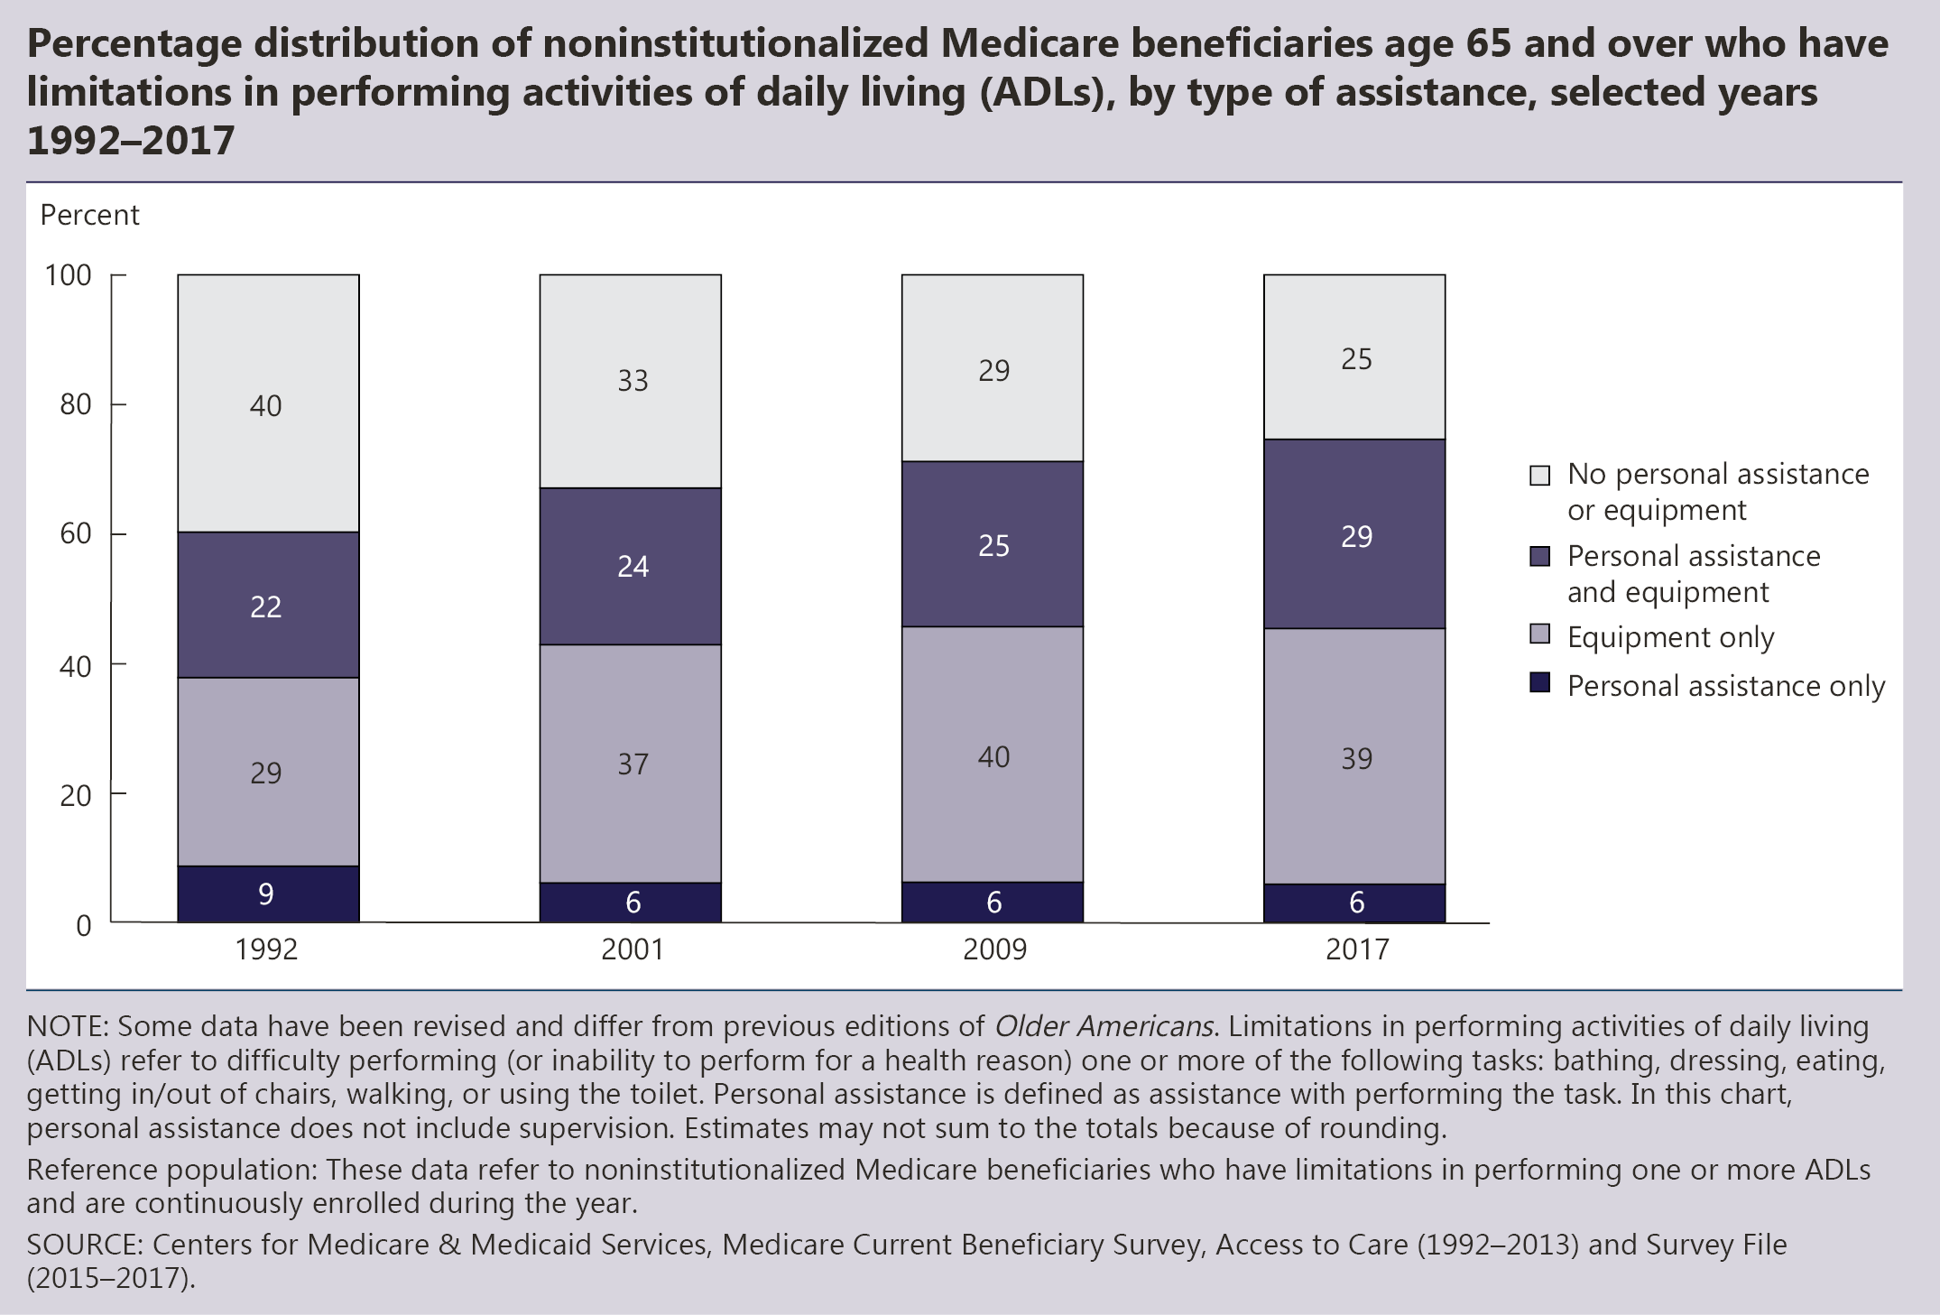
INDICATOR 36: Personal Assistance and Equipment

Slide 55
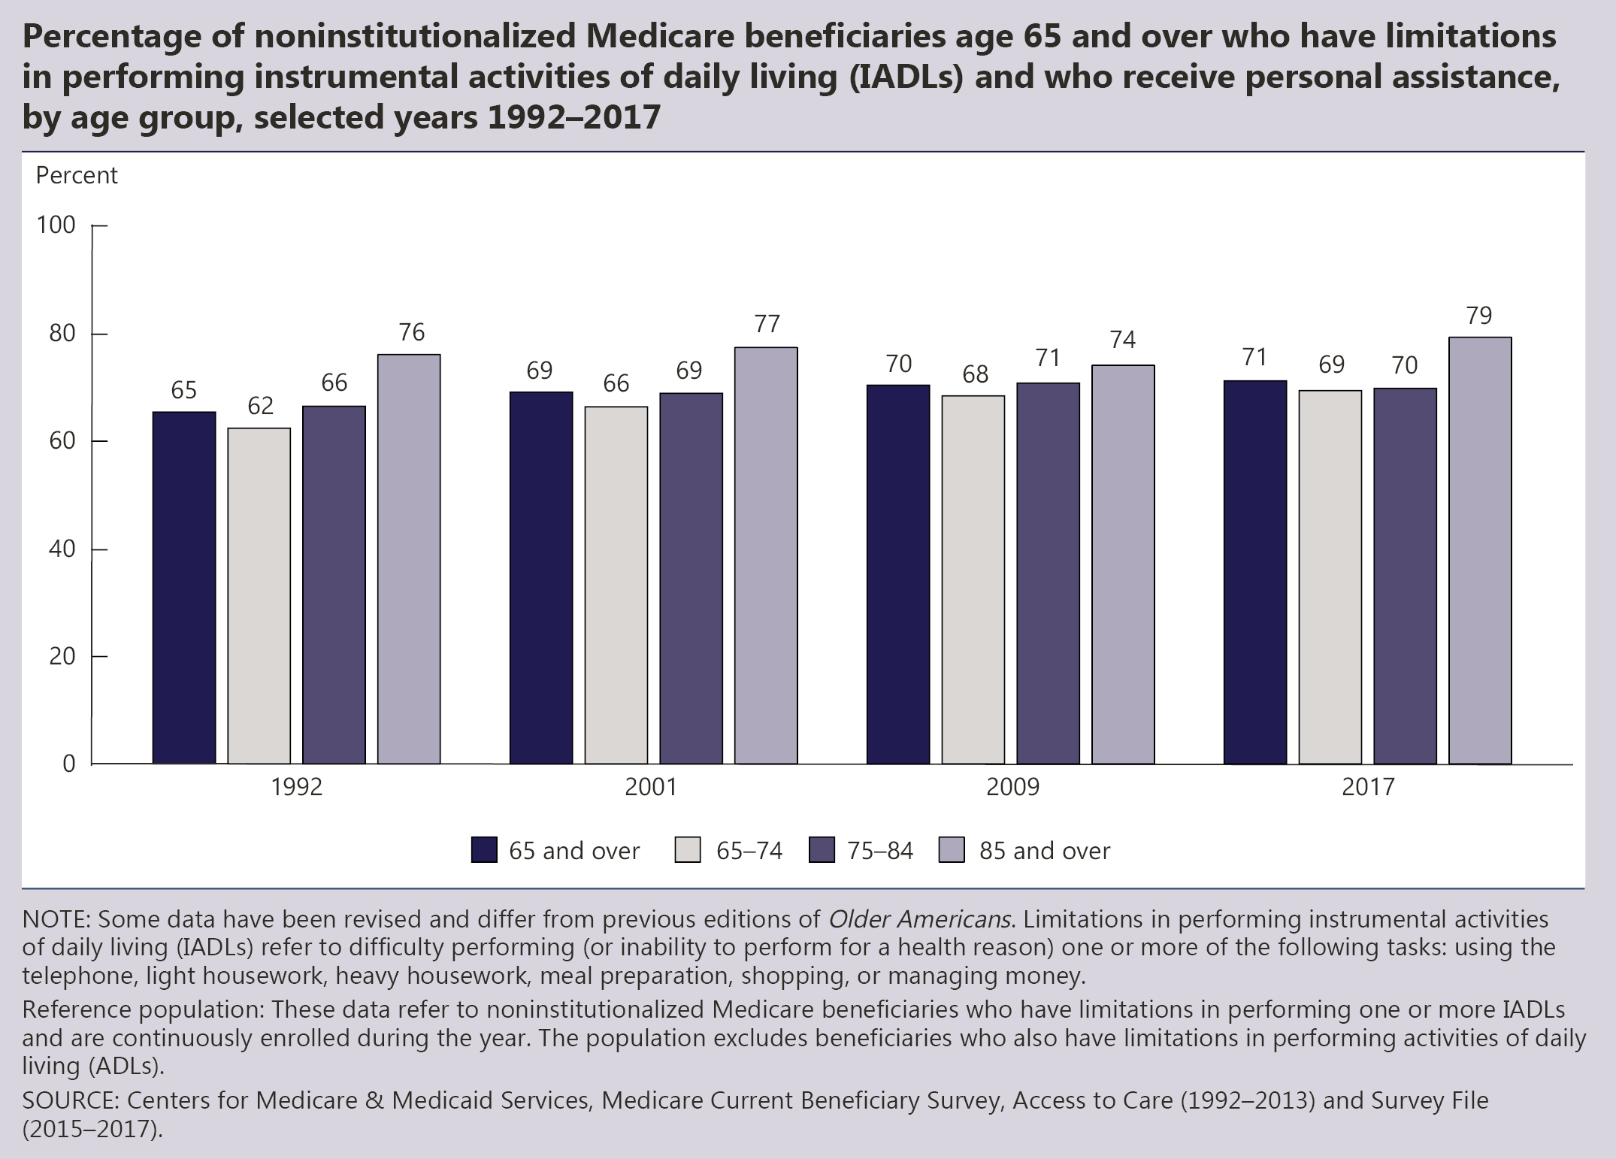
INDICATOR 36: Personal Assistance and Equipment (continued)

Slide 56
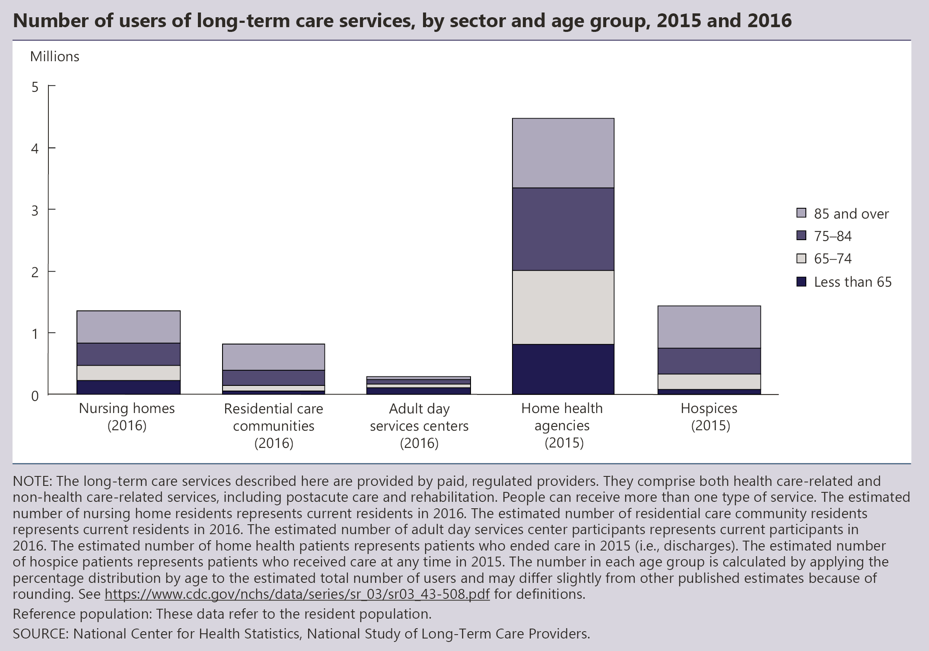
INDICATOR 37: Long-Term Care Providers

Slide 57
INDICATOR 37: Long-Term Care Providers (continued)

Slide 59
INDICATOR 38: Use of Time

Slide 60
INDICATOR 38: Use of Time (continued)

Slide 61
INDICATOR 39: Air Quality

Slide 62
INDICATOR 39: Air Quality (continued)

Slide 63
INDICATOR 40: Transportation

